Slide 2
What is Bulk Delivery?
Used to track deliveries of bulk products (liquid CO₂, liquid oxygen, etc.) into tanks that are located at customer sites
Supports printed delivery confirmation to customers on the spot
Delivery data can be integrated back into business systems for billing purposes
Forecasting is used to predict when a customer will need to be resupplied
Three Steps:
Registering New
Performing Bulk Delivery
Forecasting
Feature is available for: Standard and POD

Slide 3
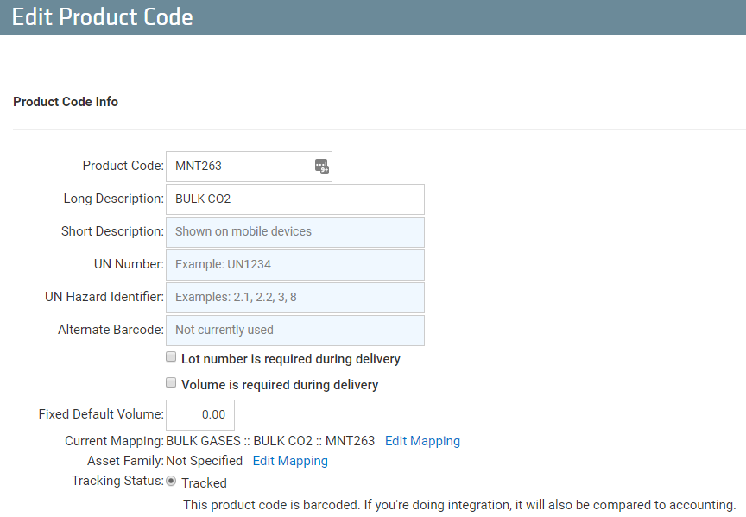
How to set up Bulk Delivery
Once TrackAbout enables the Bulk Delivery Module, there are two required setups:
Setup Asset (Type) Classifications
Map Product Code to
match Asset Type

Slide 4
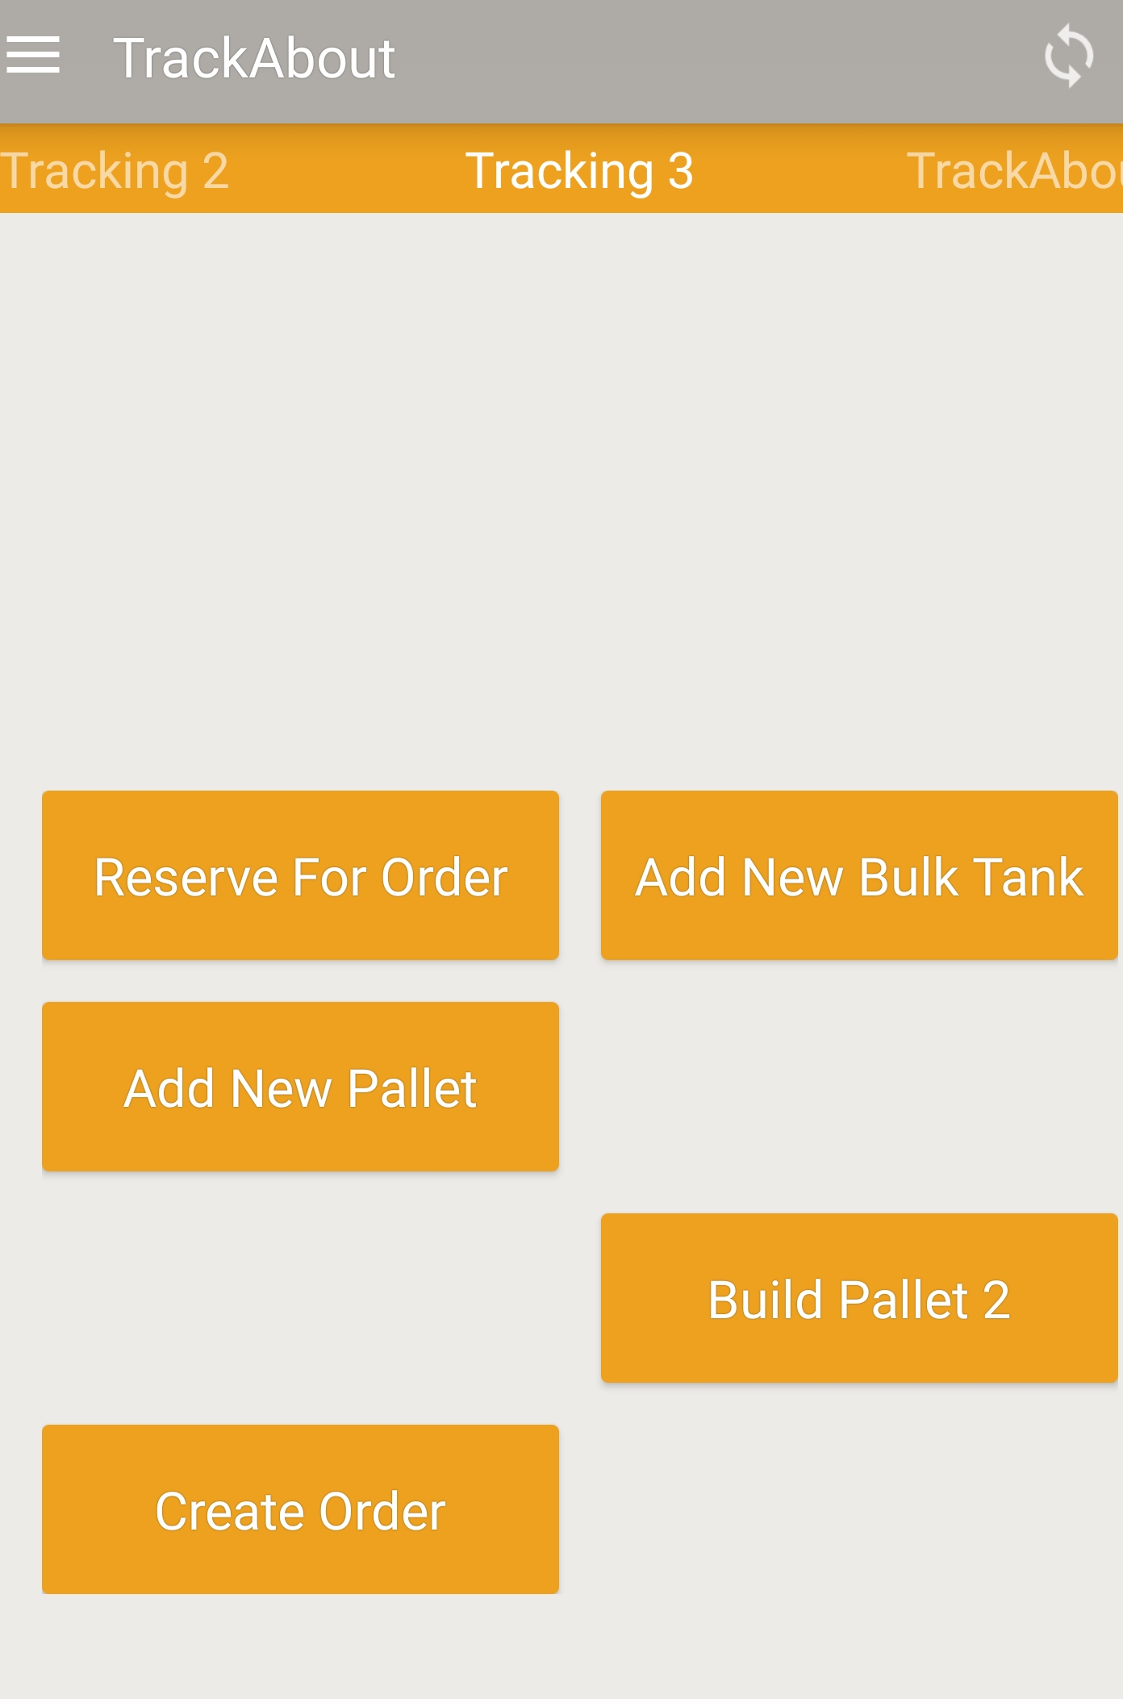
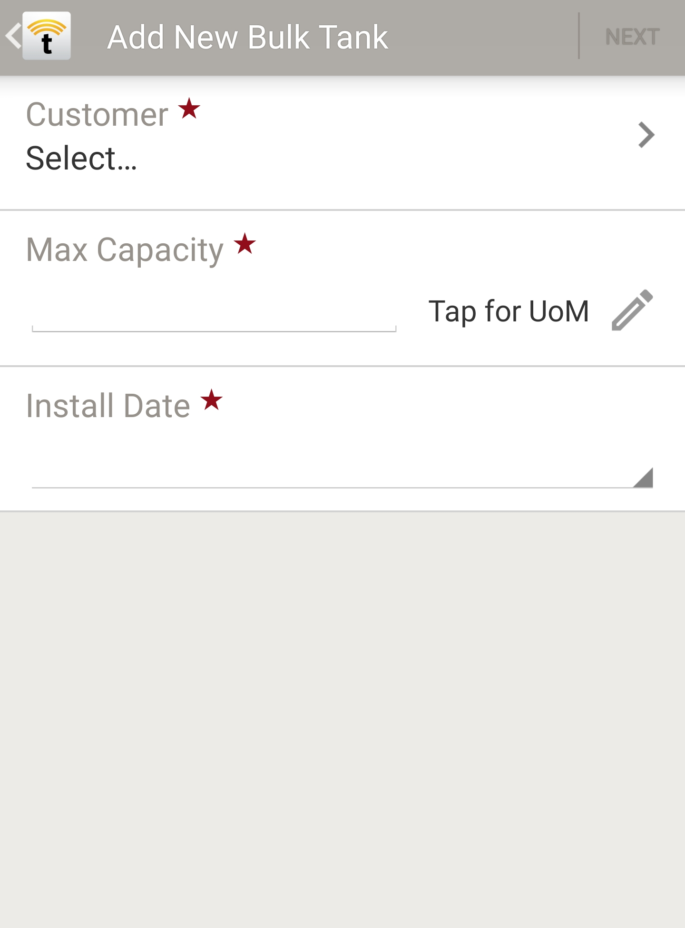
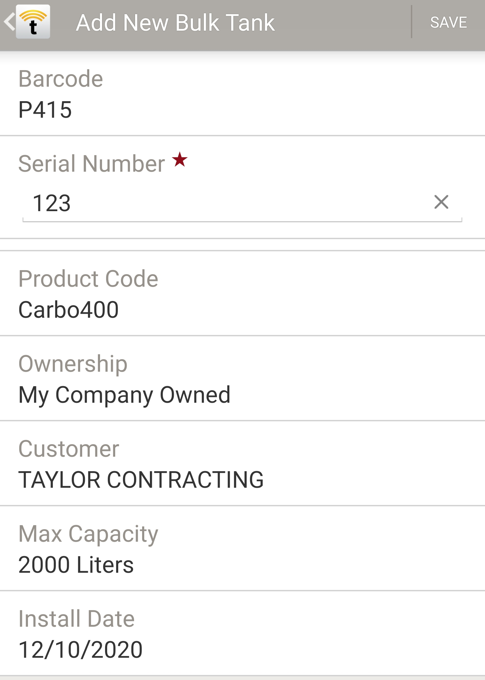
How to Register Bulk Tanks
2. Add Barcode or SN
3. Select Product Code
4. Select Ownership
1. Add New
5. Submit Attributes
6. Save
6.
1
5.
1
2.
1
1.
1
3.
1
4.
1

Slide 5
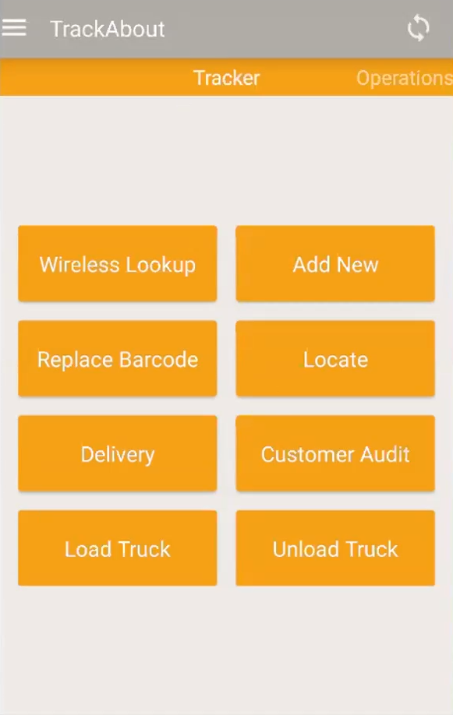
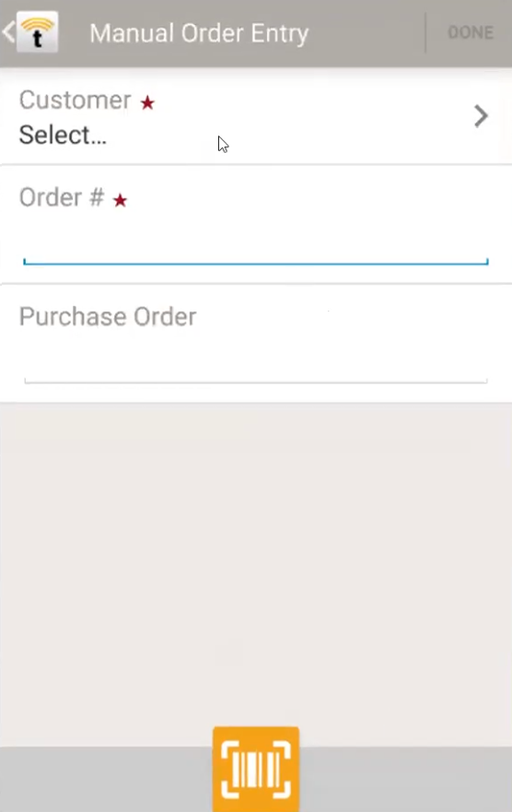
Simple Delivery Process
3.
Select “Delivery”
Type, Select, or Scan
Customer
Order #
PO Order
Done
1
2.
1
1.
1

Slide 6
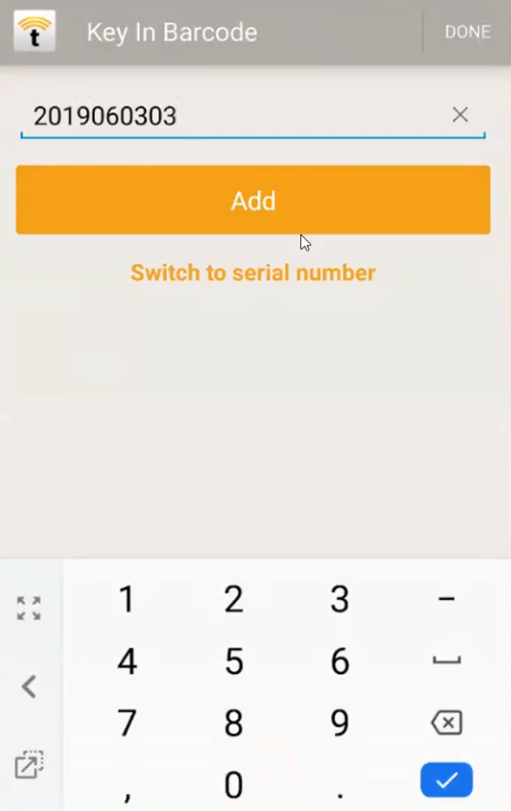
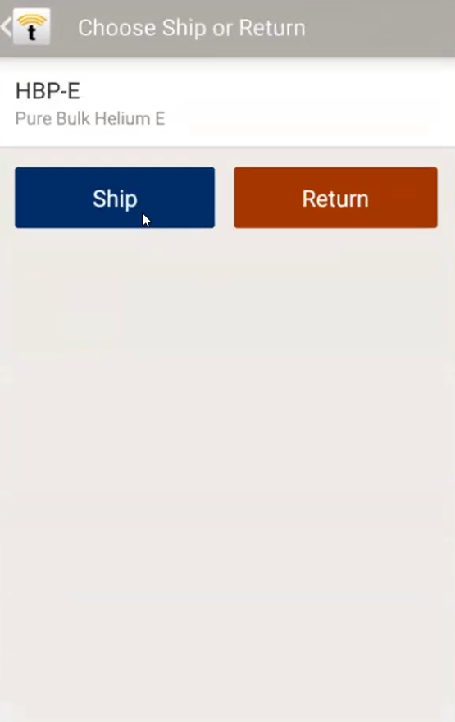
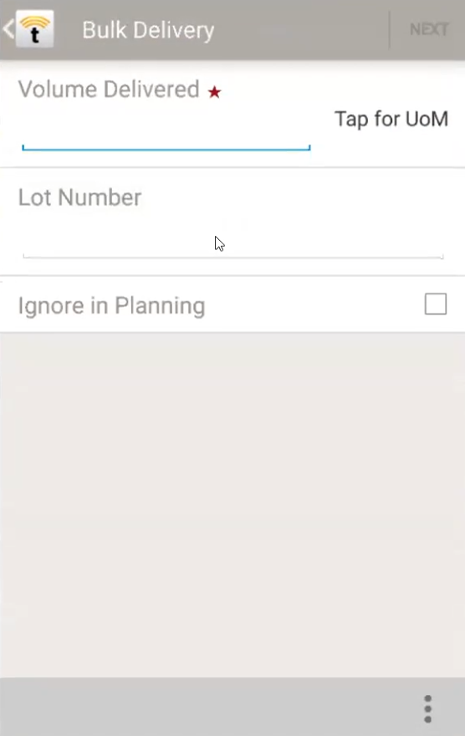
Process when Bulk Tank is Scanned
Scan or type
in barcode
2. Select Ship means
“Fill” a bulk tank
3. Complete the bulk
delivery details
1.
1
3.
1
2.
1

Slide 7
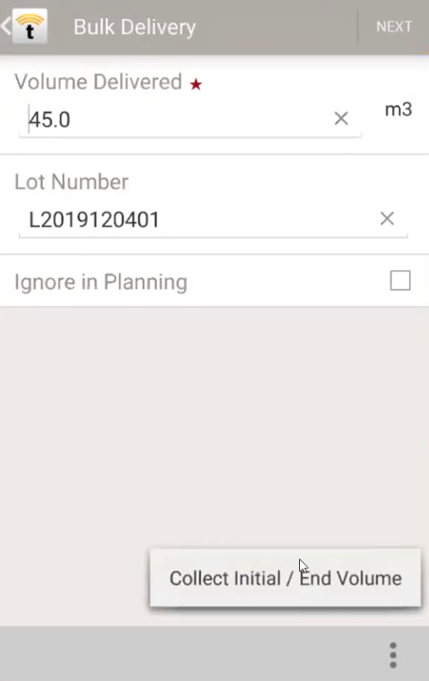
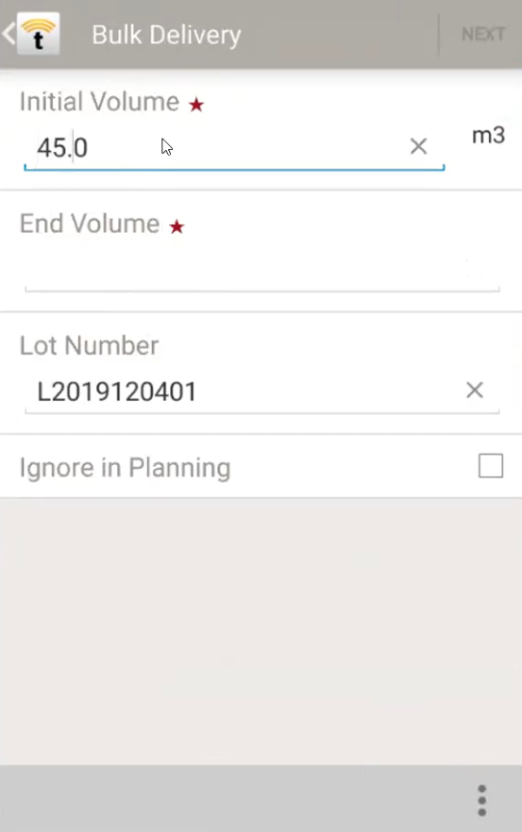
Collecting Volumes
Users have two options for recording the volume delivered to a bulk tank
Manual entry
Record Exact Volume
Calculated Value
Select “Collect Initial / End Volume” from bottom right
Then input the Initial Volume and the End Volume
1.
2.
1
1
2.
1
★★★ The application will remember which option was used for future deliveries ★★★

Slide 8
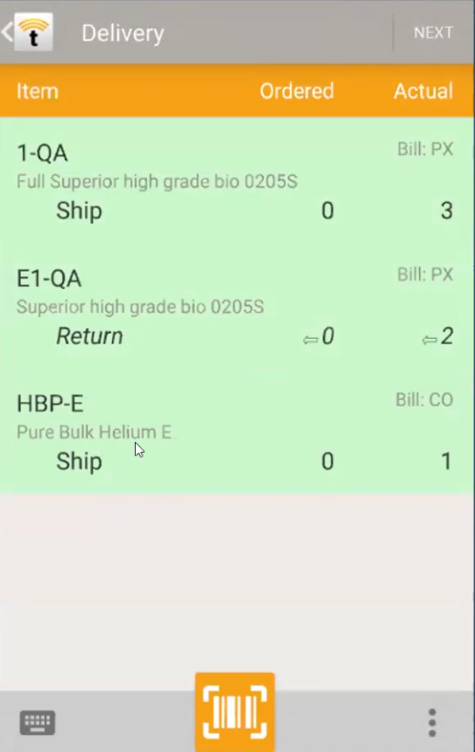
Seamless Delivery Experience
Ship and Return
Regular (Scanned) Assets
Not-Scanned Assets
Bulk Tanks
All on the same Order

Slide 9
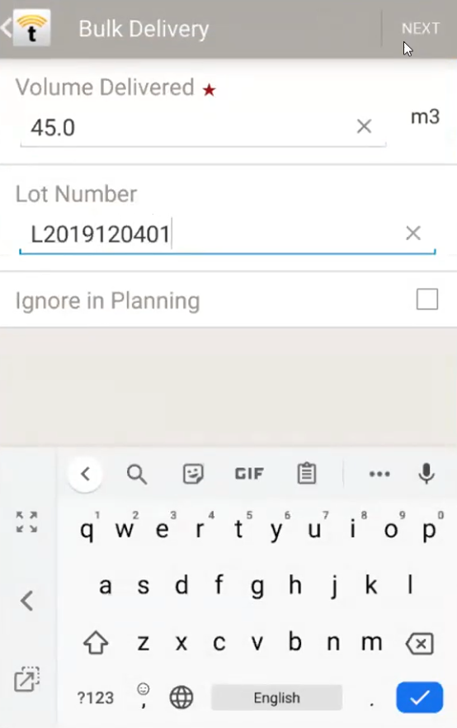
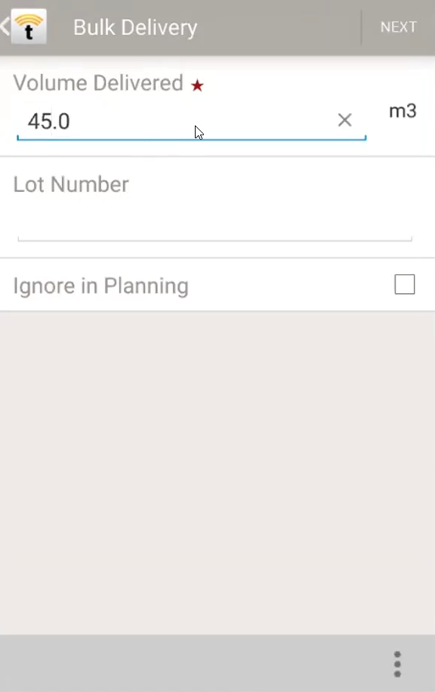
Easy Corrections and Modifications
3. Also modify
Lot Number
Select the Bulk Tank
2. Edit the Volume
Delivered
2.
1
3.
1
1.
1

Slide 10
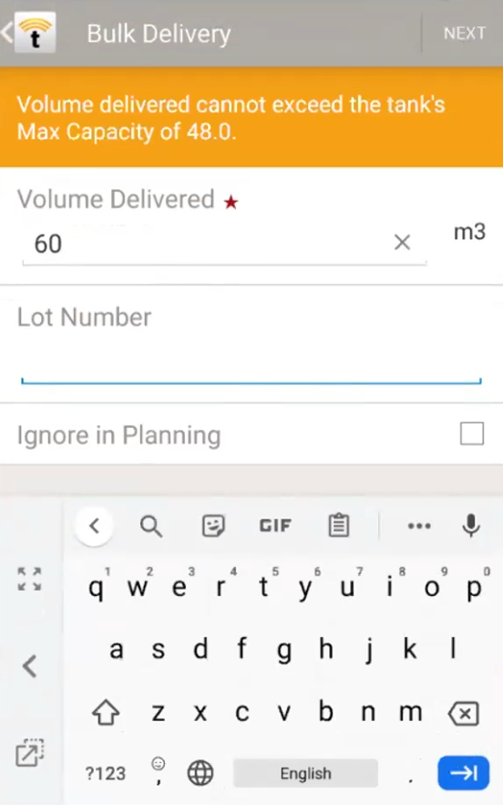
Logic for Bulk Delivery
After the user types in “60” for Volume Delivered and then attempts to proceed by selecting Next…
The bulk tank logic recalls the Max Capacity value from the registration process and alerts the user if an error is encountered

Slide 11
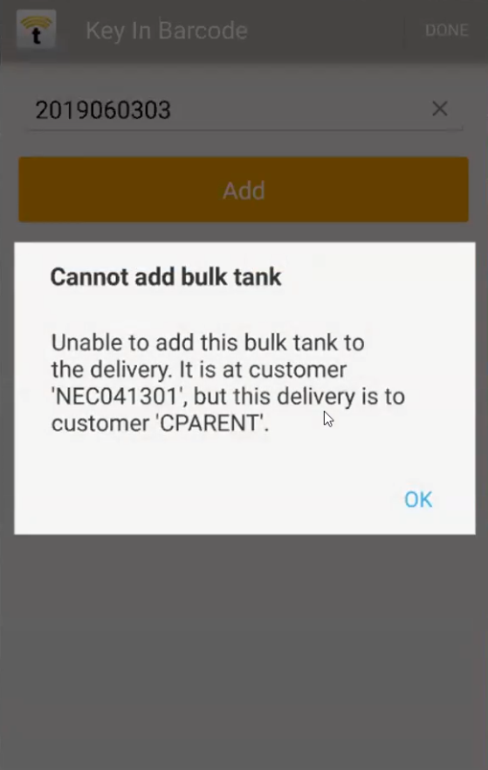
Additional Logic for Bulk Delivery
1. Once user has selected
the Customer and Order #
2. If user scans a bulk
tank that belongs to
a different customer…
A notification will appear letting them know which customer they had selected and who the bulk tank belongs to
1.
1
2.
1
★★★ If the instance is set to scan assets first (instead of inputting customer and order information), and they scan a bulk tank, it will auto fill in the customer that the delivery is being made to ★★★

Slide 12
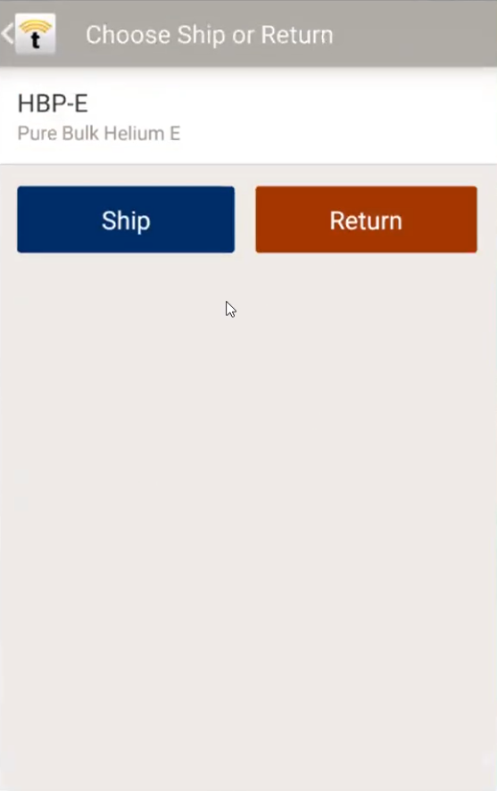
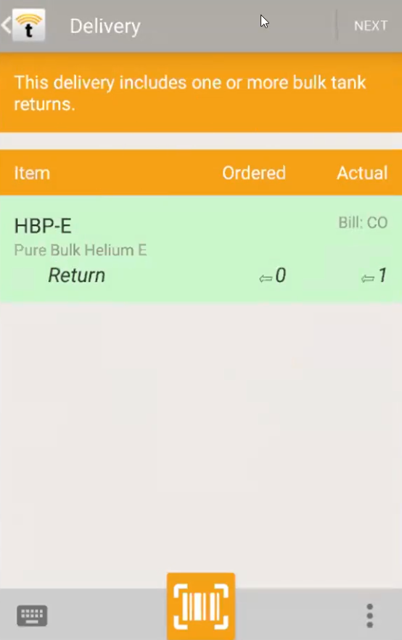
Performing a Return
If a user scans a bulk tank and selects the Return option
2.
1
2. A drop down
alert will appear to notify the user that they are performing an uncommon procedure
1.
1

Slide 13
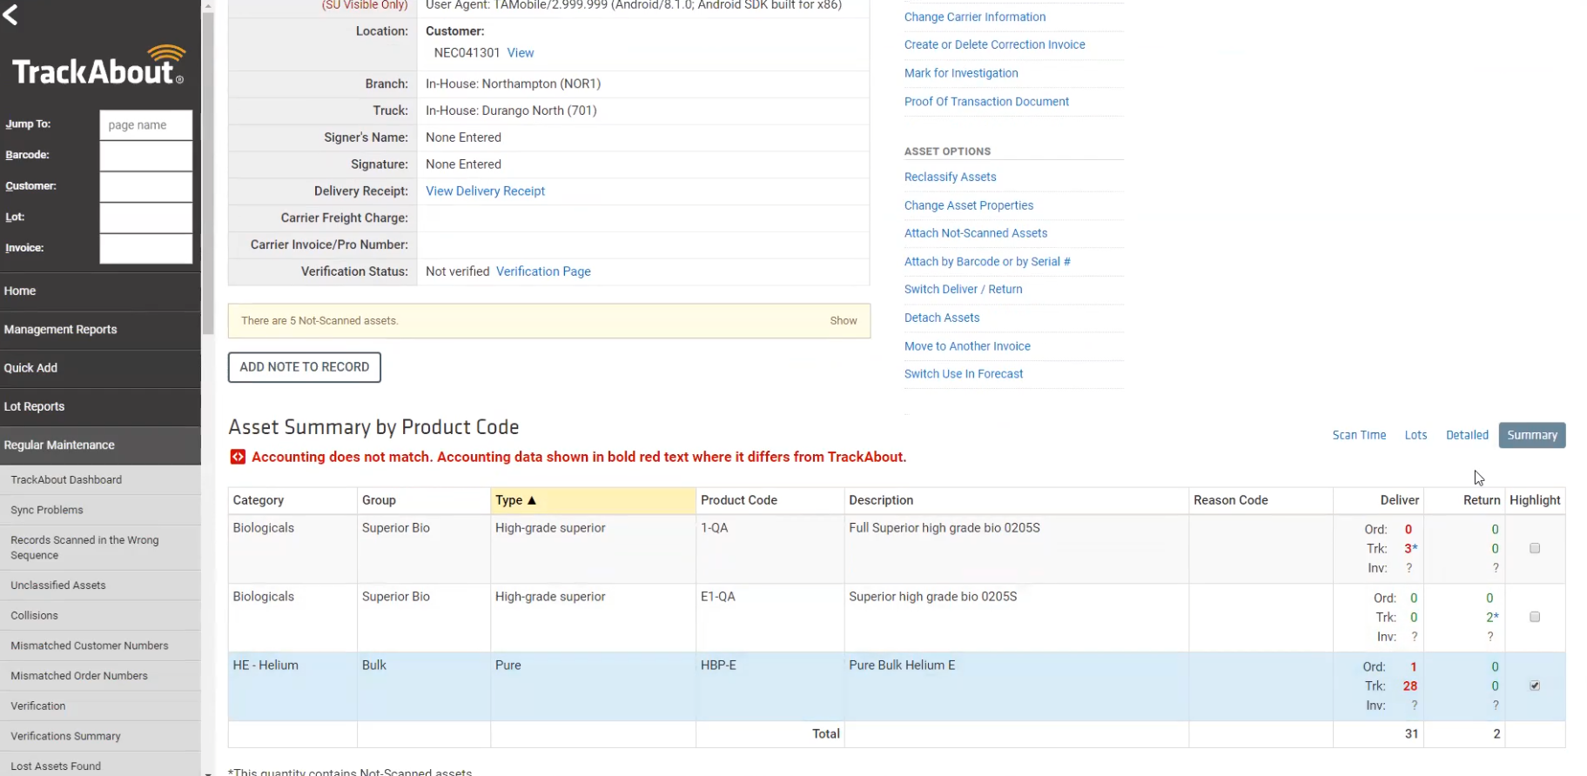
Bulk Delivery Record - Summary View
Summary view for the record, shows the volume that had been delivered

Slide 14
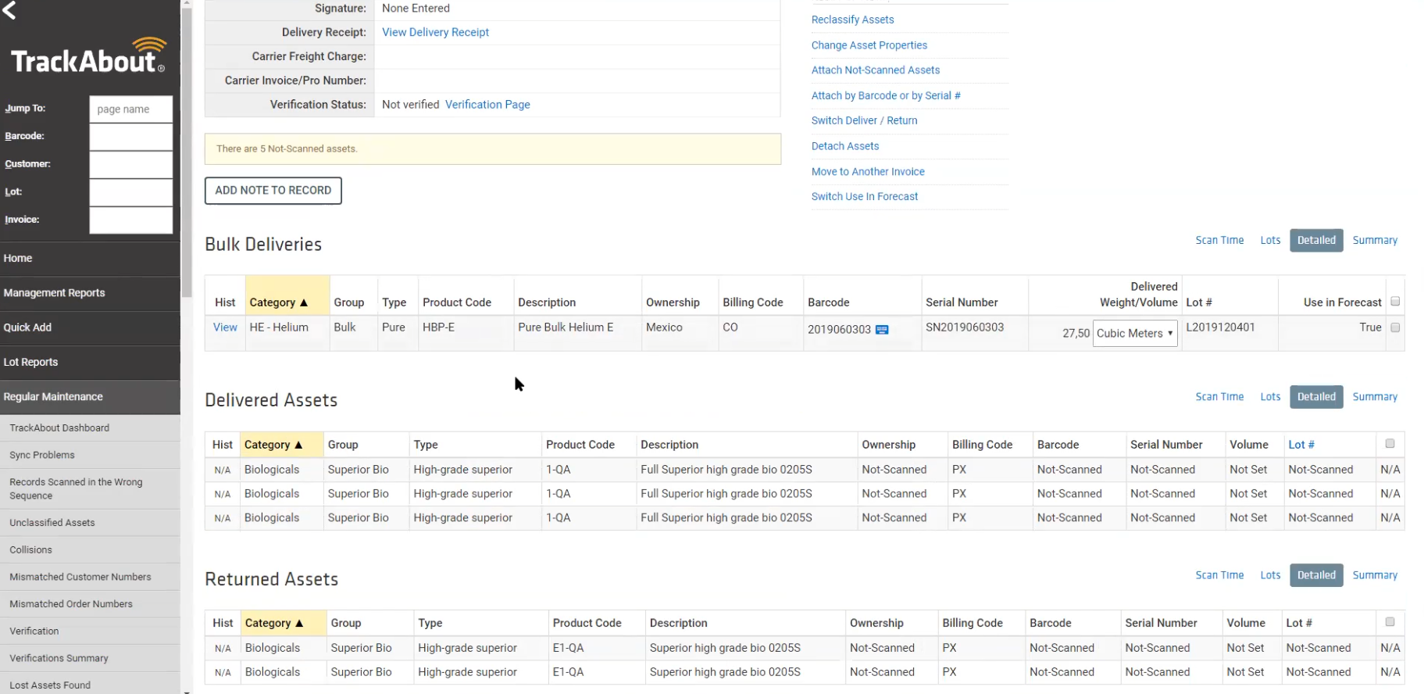
Bulk Delivery Record: Detailed View
The Detailed view shows that exactly 27.5 cubic meters of product were delivered

Slide 15
Bulk Tanks and Lot Numbers
Bulk Tanks can and will have multiple lot numbers within them
These differ from cylinder or tote types of assets since they are only ever assigned one lot number at any given time
Lot numbers for bulk tanks are still important to collect in order to account for deliveries at different dates
***Our current lot search tools don’t work yet with this.

Slide 16
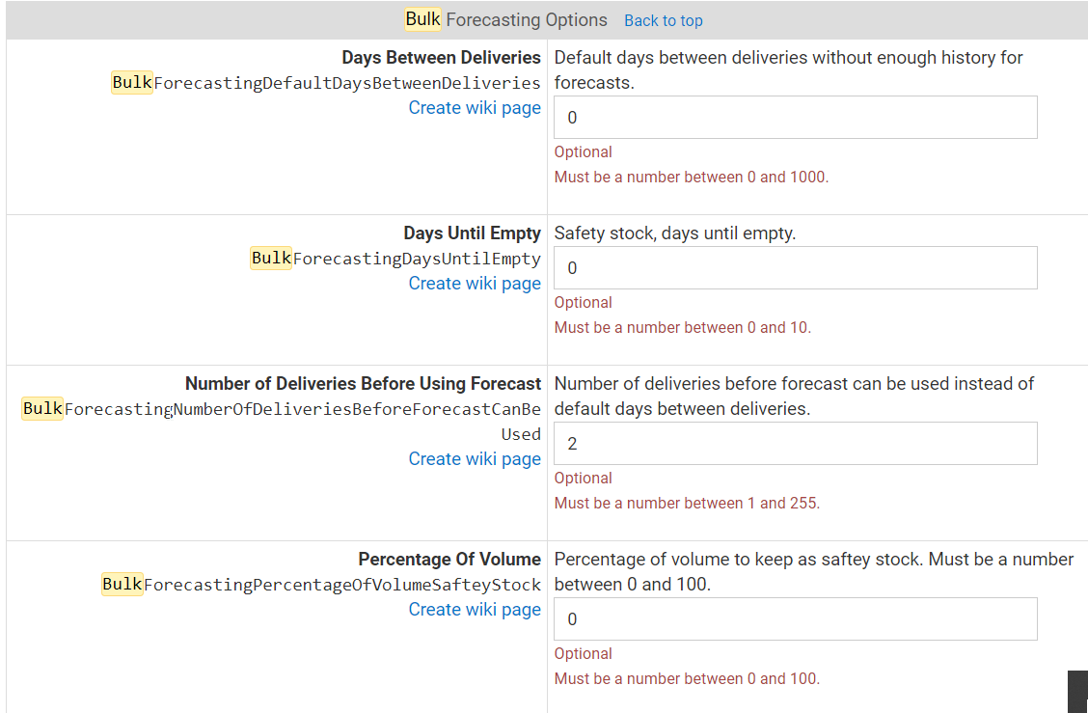
Bulk Forecasting Reporting
Bulk Tank Forecasting settings can be located under:
Bulk Forecasting Options

Slide 17
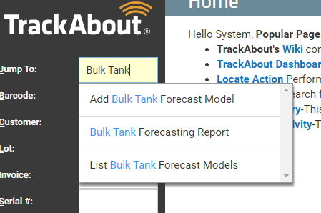
Bulk Forecasting
Three important pages are:
Add Bulk Tank Forecast Model
Bulk Tank Forecasting Report
List Bulk Tank Forecast Models

Slide 18
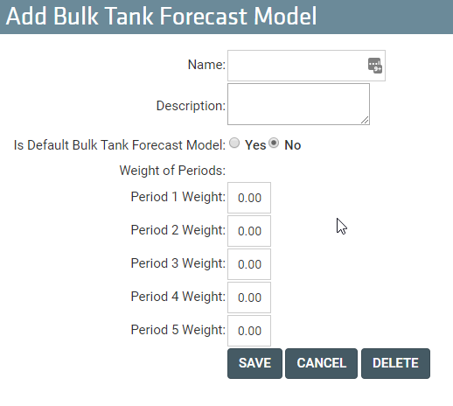
Add Bulk Tank Forecast Model

Slide 19
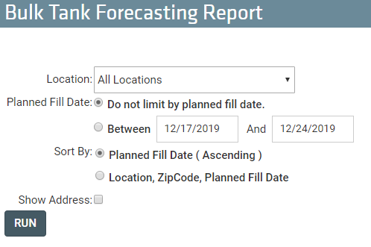
Bulk Tank Forecasting Report

Slide 20
List Bulk Tank Forecast Models

