Slide 1
POD Smartphone Training Pack
February 21, 2017

Slide 2
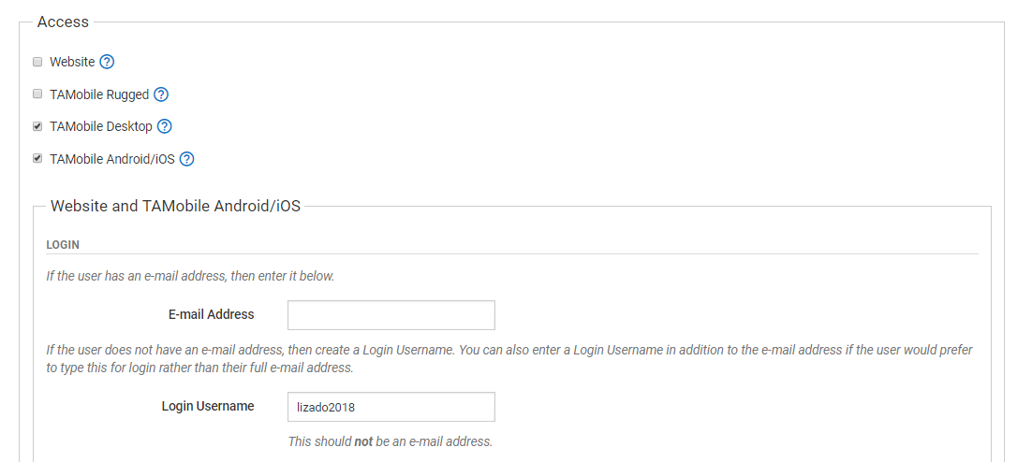
Giving Access to Smartphone
From a user’s profile in TrackAbout (via the Internal Users page), go to the Access section and check the box for Android/iOS

Slide 3
User set up for Truck Drivers
Like the Mobile Units page, each POD user must initially be set up with a Working Location, Truck, and Route.
NOTE: The Working Location and Truck can be changed from the Smartphone once initially set up
Working Location – for drivers this is likely to always be the same as the location they are assigned to, but for administrators that move locations they are likely to switch locations for delivery. This helps filter Route choices and orders
Load Inventory for this Truck or Branch – select the appropriate truck to download the unique assets to the Smartphone
Route – filters the appropriate orders to the Smartphone

Slide 4
CHANGE SCREENSHOT

Slide 5
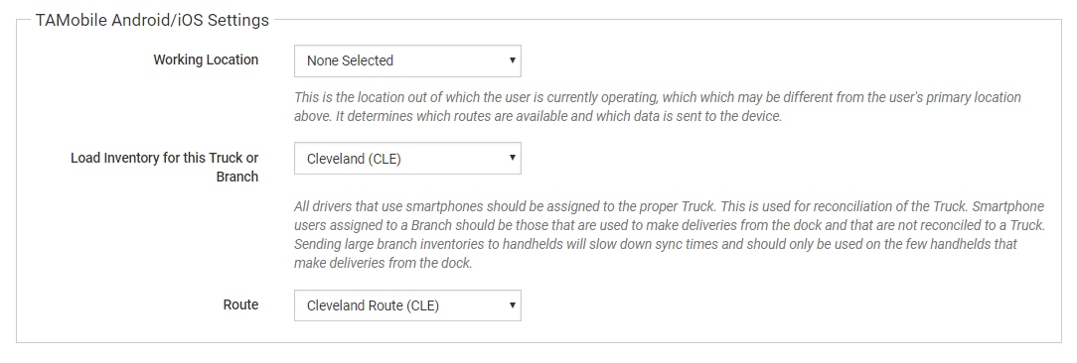
User Set Up for Counter Sales
For users that don’t fulfill orders using a truck and instead help customers at the dock (will call/customer pickup) or counter, be sure to set up them up to download the inventory for their branch
NOTE: This will download the unique assets of a branch to the Smartphone so that deliveries can be made without using the Load and Unload Truck functions

Slide 6
Picking
The Picking action is used to pick assets in preparation to be loaded onto a specific truck and trip using the Smartphone.
Assets to be picked are generated based off of the orders loaded onto the handheld for customer delivery.
In order to use the Picking action, all orders must be initially routed with trips and trucks
NOTE: A trip is a collection of orders that will be delivered together on the same truck at the same time

Slide 7
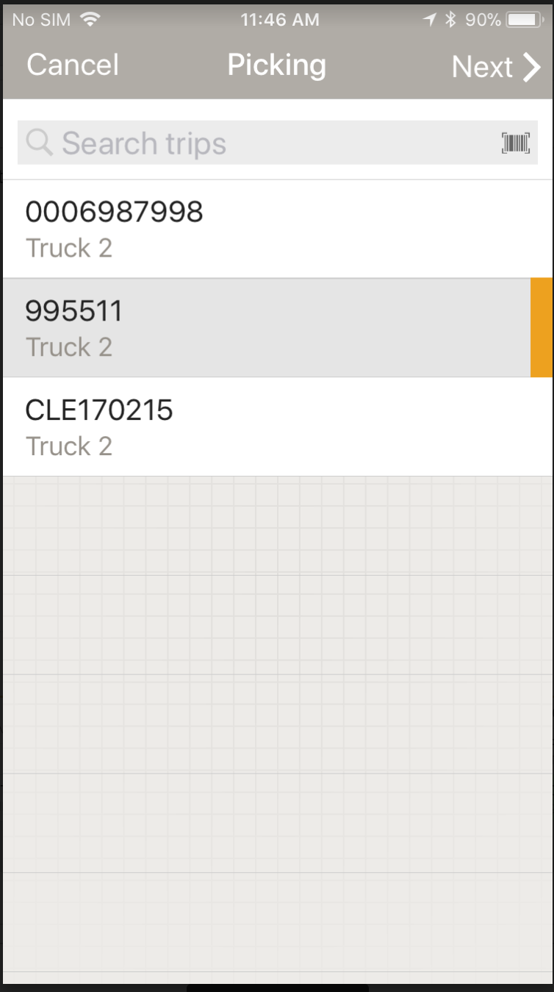
Selecting a Trip
The operator can either select from the list of available trips, scan, or begin typing the trip number
The operator will see the name of the truck that is associated with each trip number available to be picked
Tap Next

Slide 8
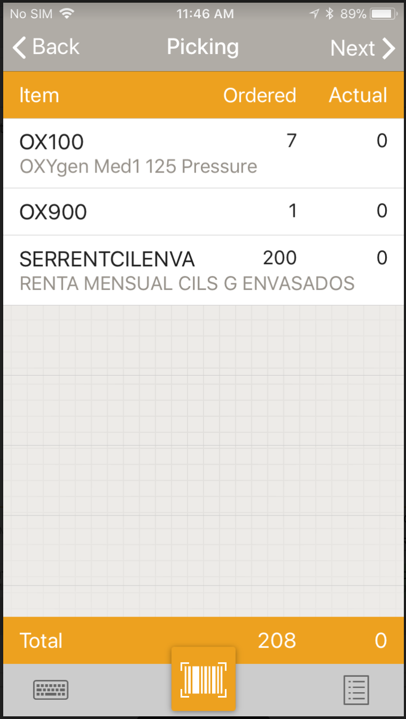
Main Screen
The main Picking screen summarizes all products for orders on the trip selected by Item No. and ordered quantities
The Ordered column shows the user the quantity of each product and/or hard good ordered
The Actual column shows the user the total of each product that has been added via scanning and quantity

Slide 9
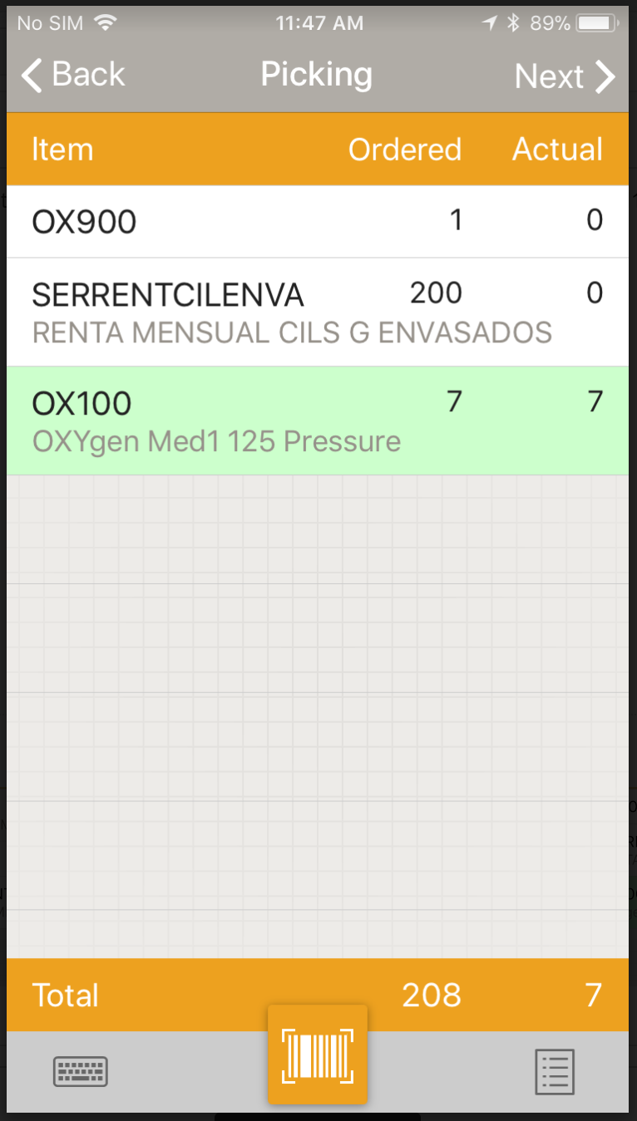
Scanning assets
Scanned Assets – tap the yellow barcode at the bottom of the screen to activate the scanning screen and begin scanning assets
TrackAbout does a lookup of each asset scanned to retrieve the product code and to ensure that the use state is appropriate for delivery
As each item is scanned and completed, the line will turn green and fall to the bottom of the picking list

Slide 10
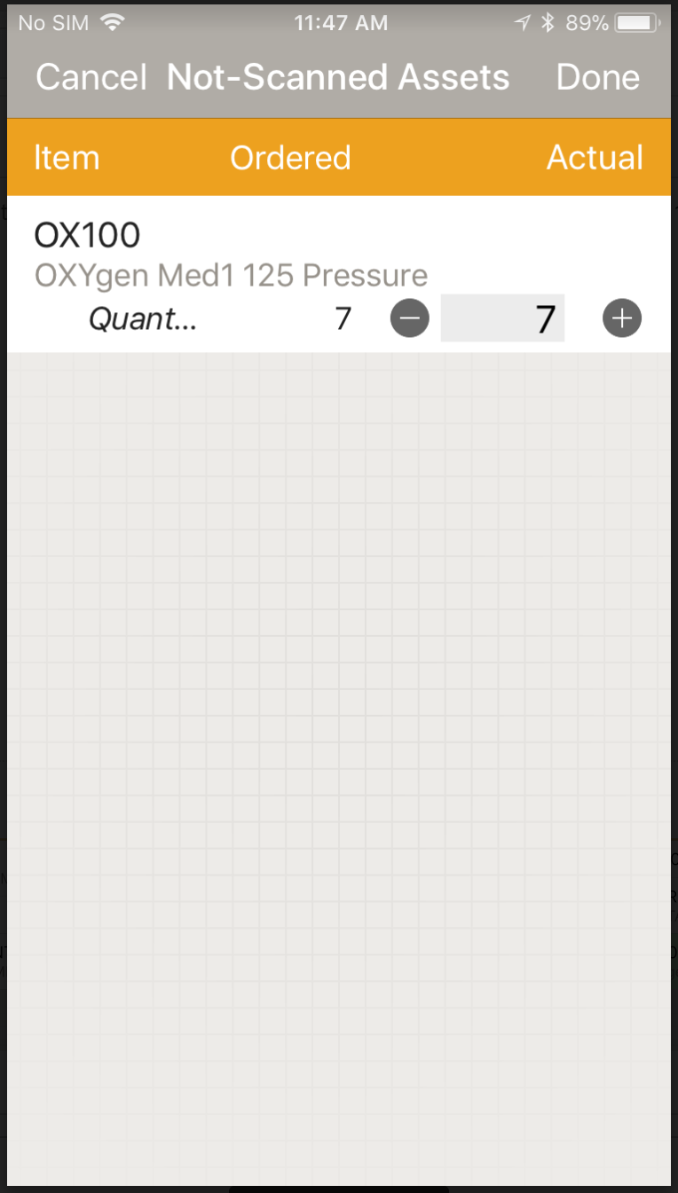
Adding Items by Quantity
When adding items (either hard goods/consumables or regular products) by product code and quantity only (without barcodes), the operator can tap on an existing line item to enter in the picked quantity
Use the ‘+/-’ signs to increase or decrease the quantity or tap in the number field to bring up a numeric keypad

Slide 11
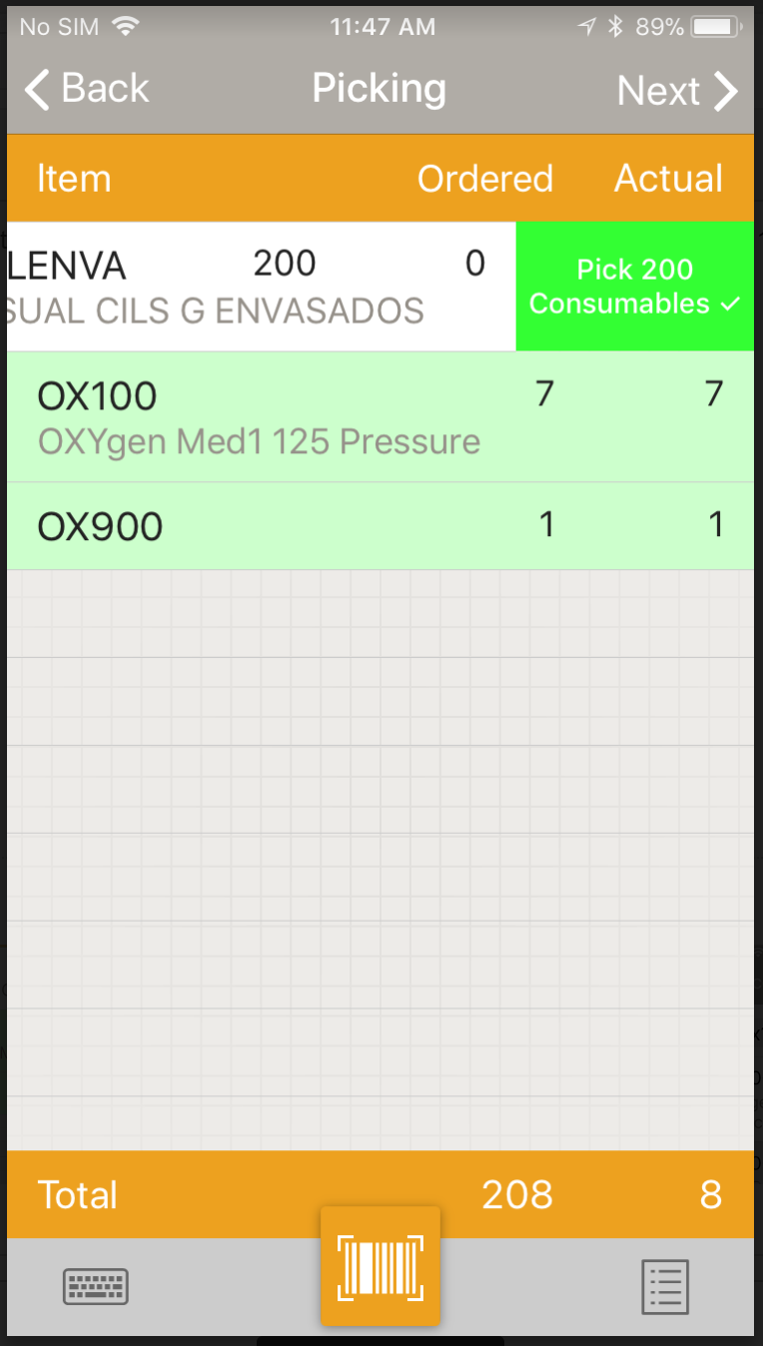
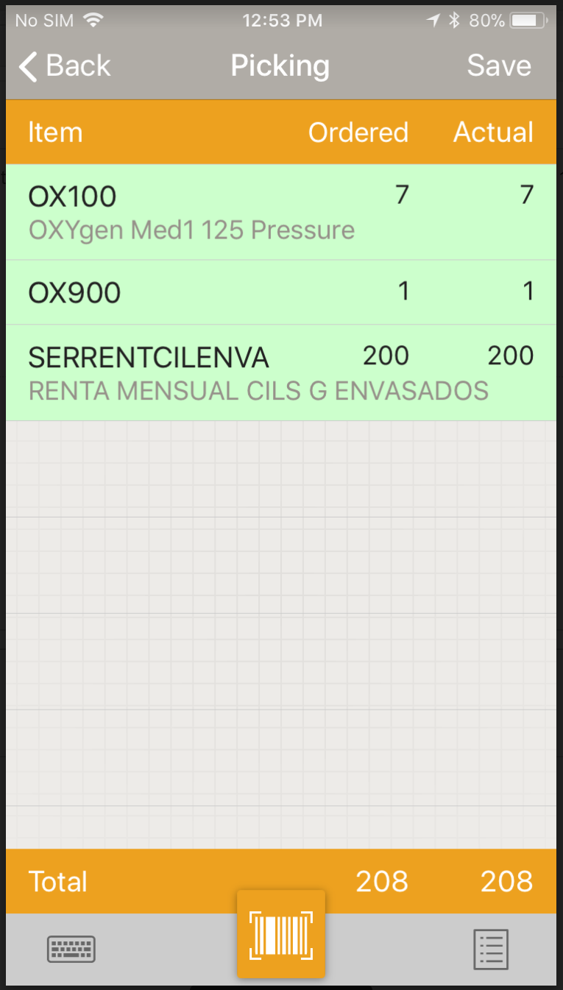
Adding Items by Quantity
For hard goods/consumables, if the operator is fulfilling the line completely, the user can swipe to the left to complete the line

Slide 12
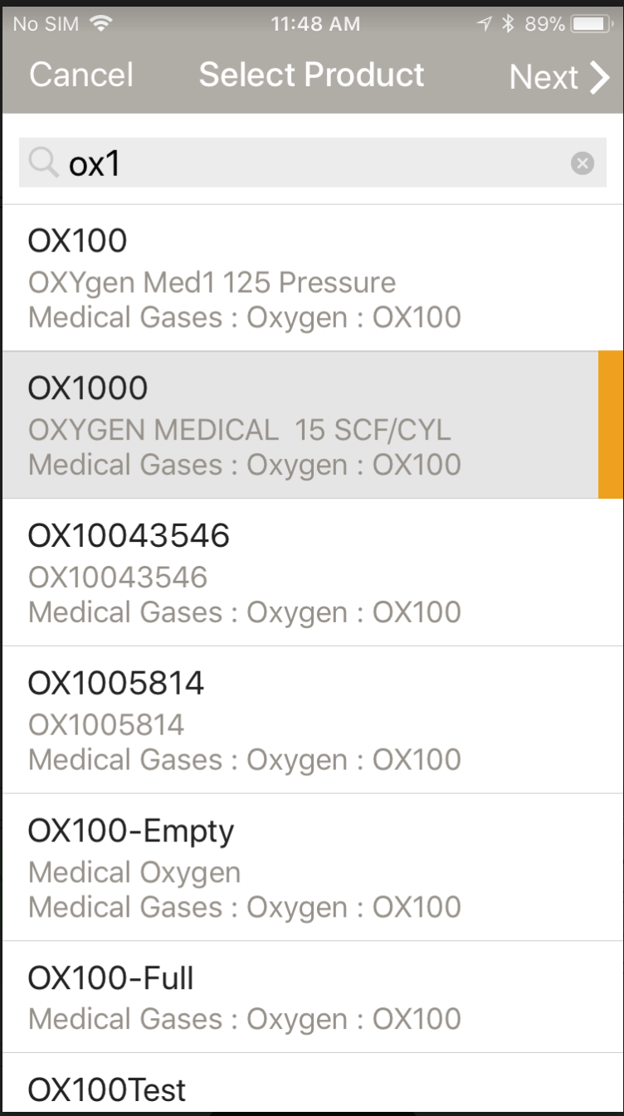
Adding Items by Quantity
If the product is not listed on the main screen, the user may tap the Note button in the bottom right hand corner of the screen and click “Add Line Item” to bring up a smart search for product codes to be added
The operator may select the product code or hard good code and quantity to be picked

Slide 13
Completing Picking
Once all lines have been completed, then the user can tap Save in the upper right hand corner of the screen
At this point the assets are NOT associated with a truck yet, and they are still in the inventory of the branch location
The use state of each unique asset that has been picked will change to Committed for Delivery to reserve it and restrict further use

Slide 14
When all Lines Don’t Match
If the number of assets ordered does not match the number of assets scanned/added during Picking, the operator will be alerted that there is a mismatch after tapping the Save button.
Tap Back to go back and fulfill each line
Tap Next To proceed with the quantities already included on the screen

Slide 15
Using Reason Codes
If the operator chooses to continue to save the Picking action with mismatched lines, customers can choose to have a list of reason codes that the operator must choose from and assign to each mismatched line
The operator may tap on each mismatched line to assign the required reason code; once assigned, the line turns green

Slide 16
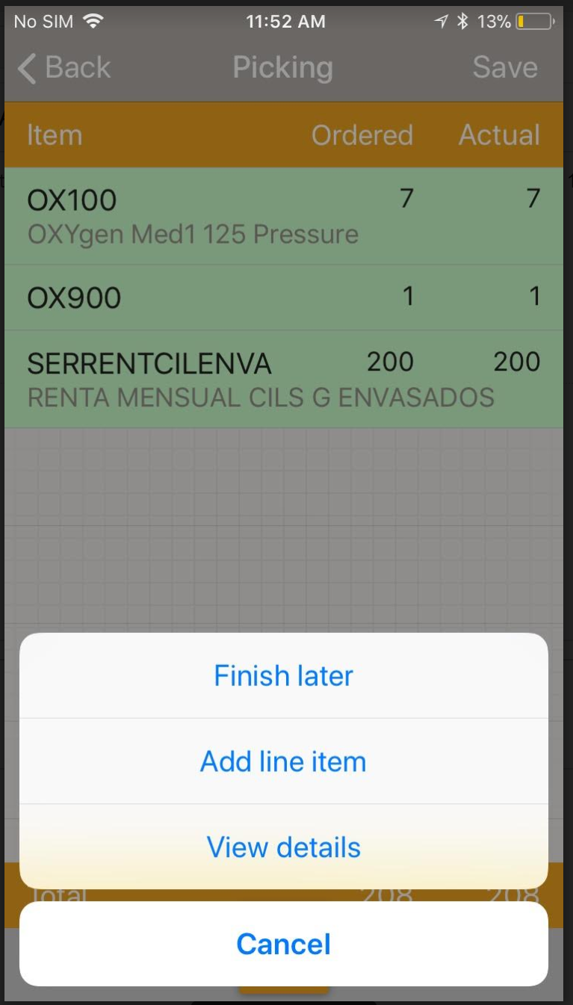
Pausing Picking
Going to the Note icon in the bottom right hand corner of the screen and selecting Finish Later will take the operator back to the Main Menu.
Operators should use Finish Later when a trip will not be picked all at the same time.
Pausing the Picking action will not change the use state of any assets until the picking action has been saved for a trip.
Any operator with Picking authorization will be able to go into the same trip again to continue picking.

Slide 17
Keying In and Removing Assets
The Keyboard in the bottom left hand corner of the screen allows the operator to key in by serial number/barcode
The View Details button (accessed via the Note) will allow an operator to view all barcodes and products added and will also allow them to remove erroneous assets by tapping or multi-selecting lines and then tapping the trash icon

Slide 18
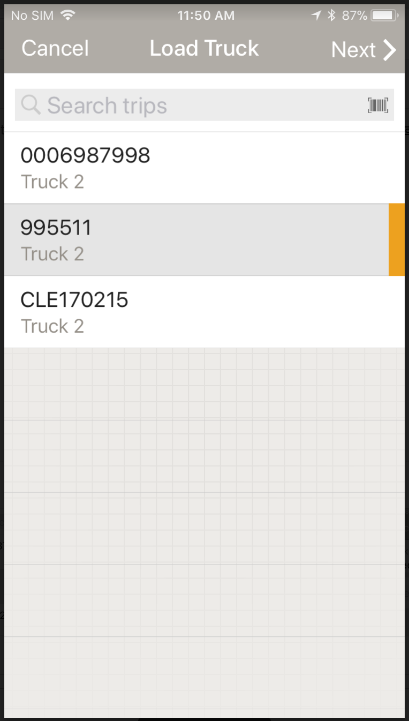
Load Truck (with Trip)
The Load Truck process moves the assets from the branch to the Truck that is associated with the trip selected during the Load Truck action.
The operator can either select from the list of available trips, scan, or begin typing the trip number
The operator will see the name of the truck that is associated with each trip number available to be loaded
Tap Next

Slide 19
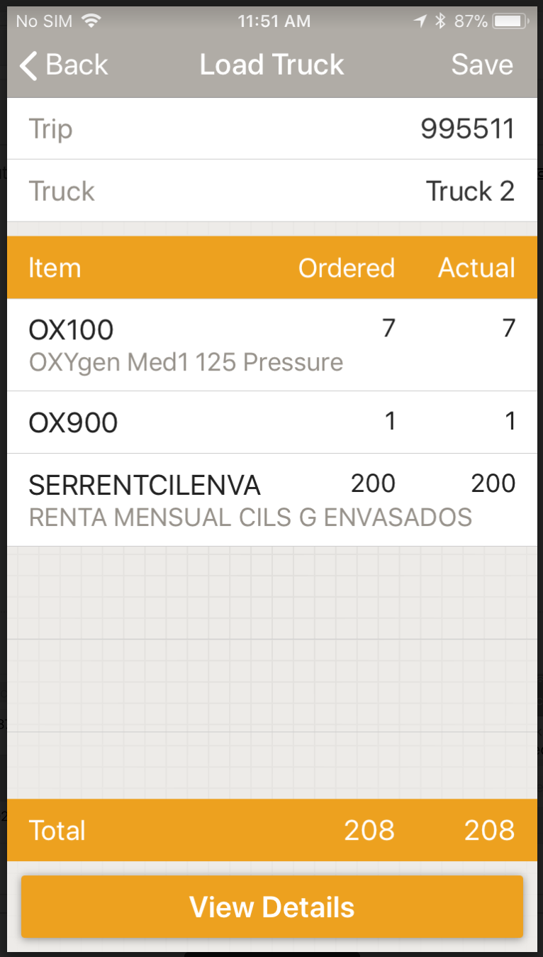
Main Load Truck Summary Screen
The operator will see a summarized view of what has been picked and loaded on the truck, including both what was ordered and actually loaded
The operator can tap View Details to view a list of barcodes and products added
If the information is correct, tap Save
The use state of the assets will be updated to In Transit

Slide 20
SYNC SMARTPHONE PRIOR TO LEAVING THE PLANT FOR DELIVERY

Slide 21
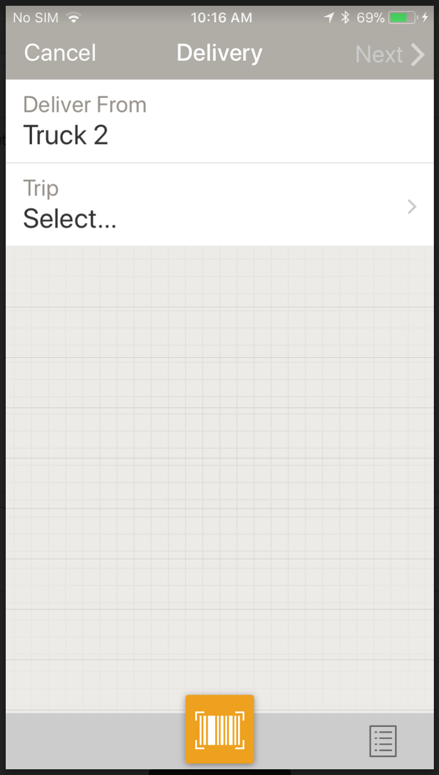
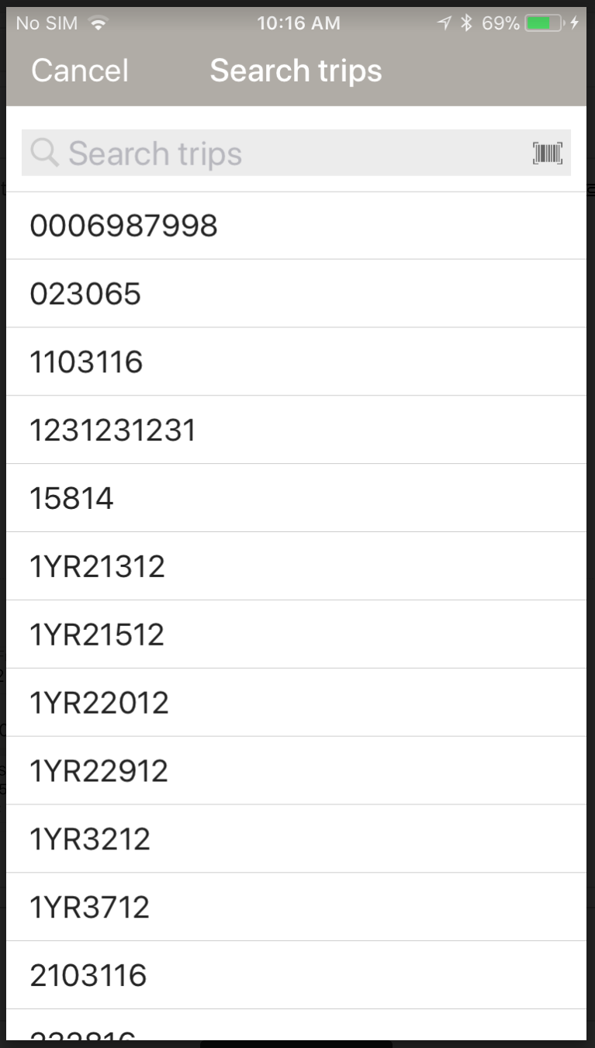
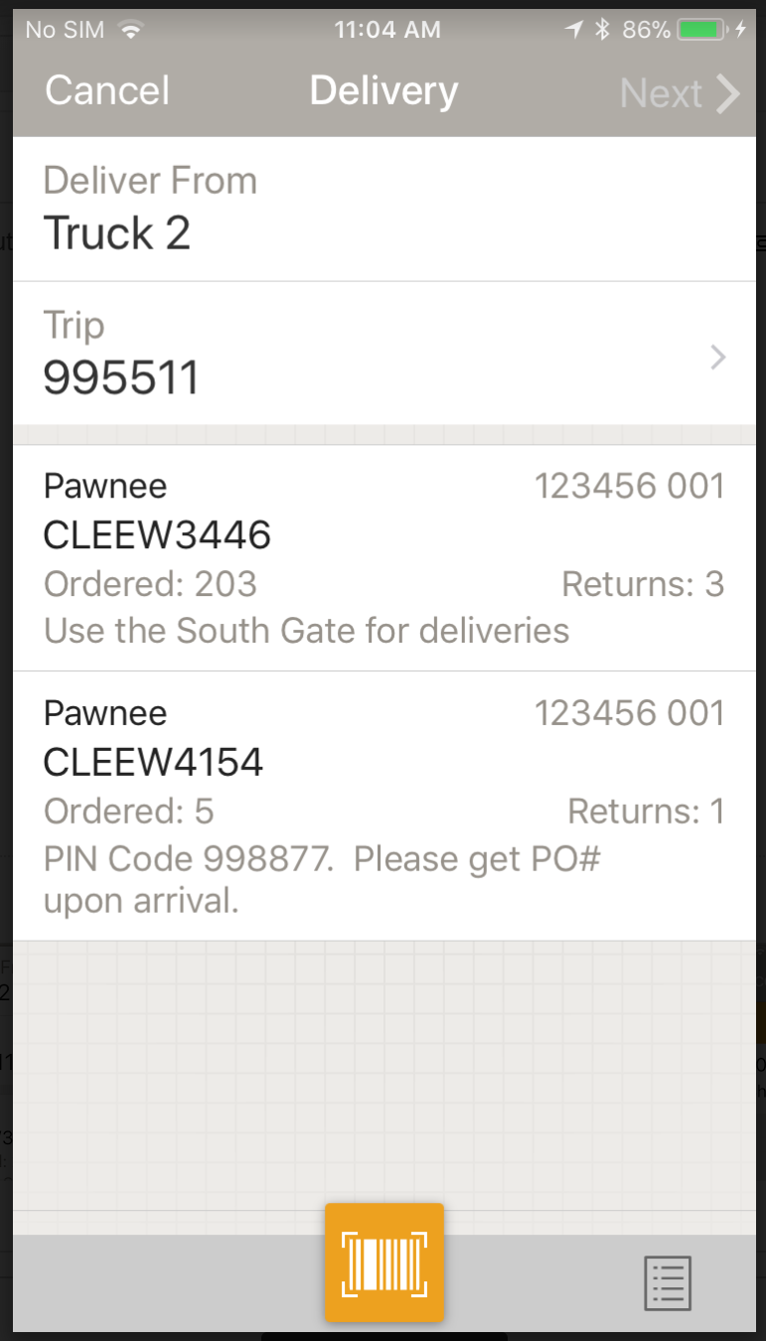
Delivery
The main POD delivery screen displays the following information for the driver:
Truck – prepopulated from the truck assignment either on the web or from the hamburger menu
Trip – if there is more than one trip, the user can tap on the Trip line to scan, type in, or select from the list of trips
Order /Delivery details:
Customer Number and ID
Order/Delivery Number
Summarized view of ordered and returned quantities
Order and Customer Comments
NOTE: All orders are displayed in routed delivery sequence
NOTE: User can tap the scan button here to scan a Trip, Order, or Truck Barcode

Slide 22
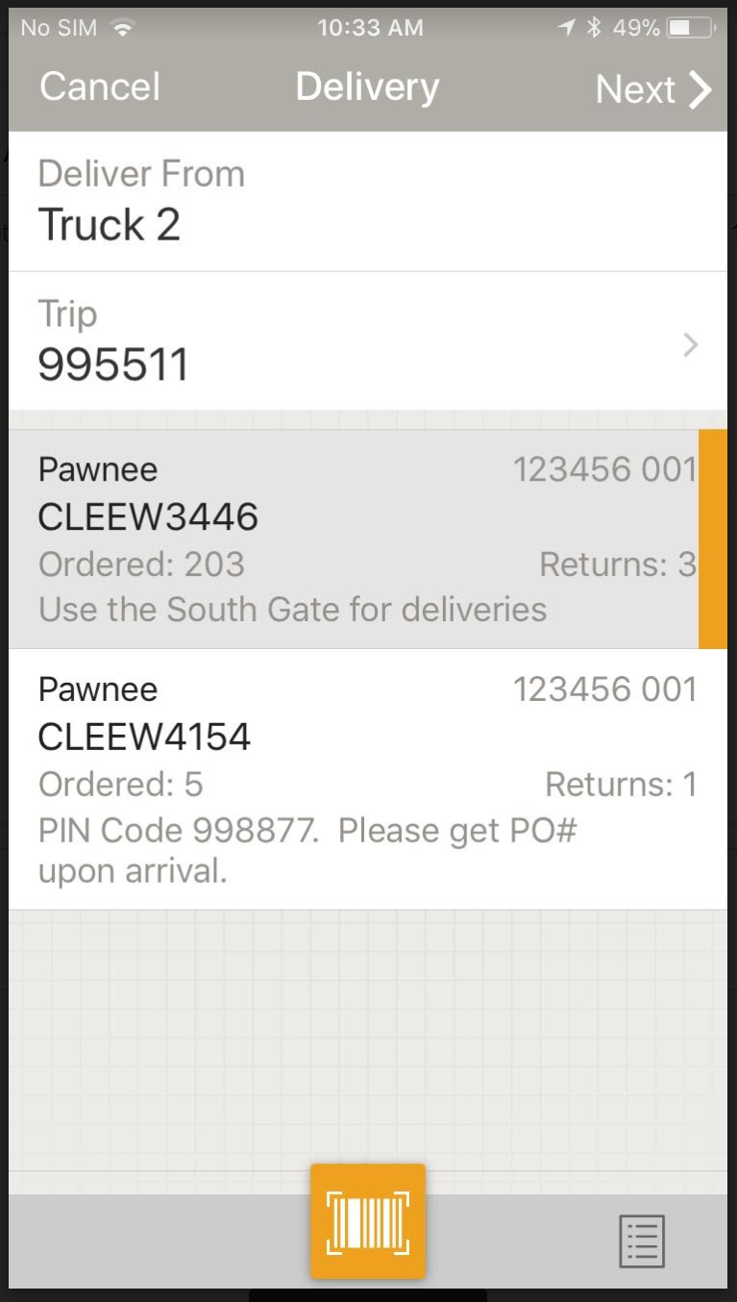
Order Selection
Once the user has tapped the order to deliver against, tap Next in the upper right hand corner

Slide 23
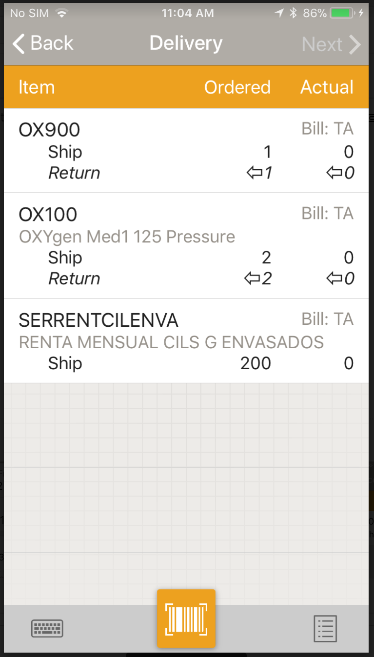
Delivery Main Screen
TrackAbout displays the following information to the operator for every order:
Item Code and Description
Ordered Quantity per Item Code
Ship – quantity to be delivered
Return – quantity to be picked up
NOTE: If you are using Full/Empty Codes, the Full Code line will only show Ship quantities and the Empty Code line will only show Return quantities
Actual Scanned/Added Quantity per Item Code
Bill (Billing Code): Will only be present for clients currently using billing codes for integration into external systems
Hardgoods cannot be returned, only shipped

Slide 24
Delivery Main Screen
Scan all deliveries and returns by tapping the yellow scan button at the bottom of the screen.
NOTE: There is no reason to tap on the line item to begin scanning
TrackAbout will automatically recognize assets that have been loaded as “shipped” assets, and assets that are at a customer as “returned” assets

Slide 25
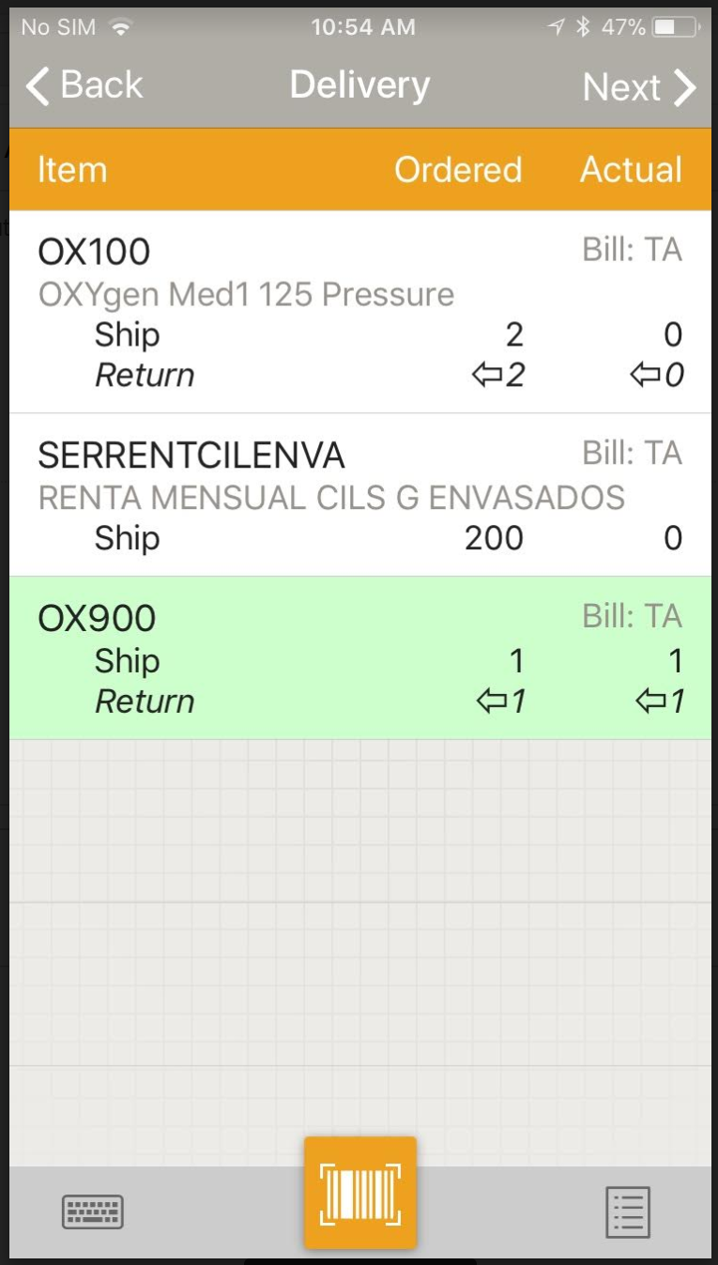
Delivering Scanned Assets
As assets are scanned, the lines are appropriately updated and as they are completed, will turn green and move to the bottom of the list

Slide 26
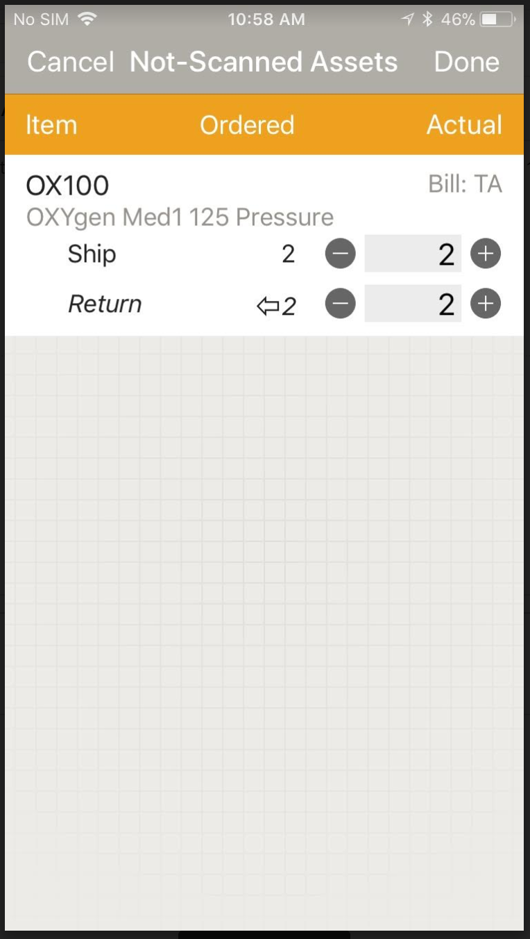
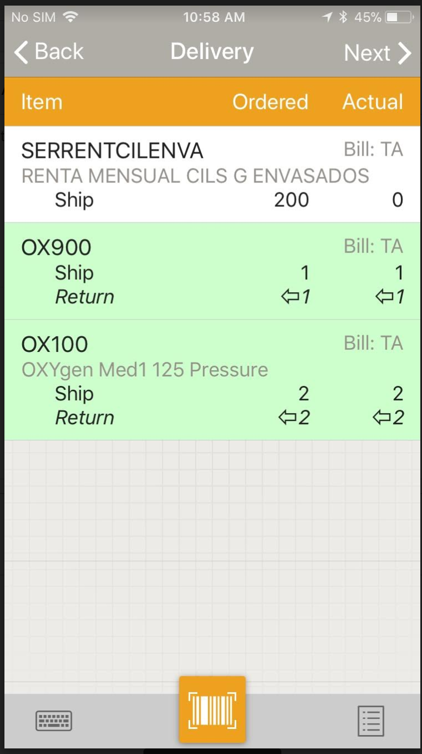
Delivering Items by Quantity
When adding items (either hard goods/consumables or regular products) by product code and quantity only (without barcodes), the operator can tap on an existing line item to enter in the quantity for ships and returns
Use the ‘+/-’ signs to increase or decrease the quantity or tap in the number field to bring up a numeric keypad

Slide 27
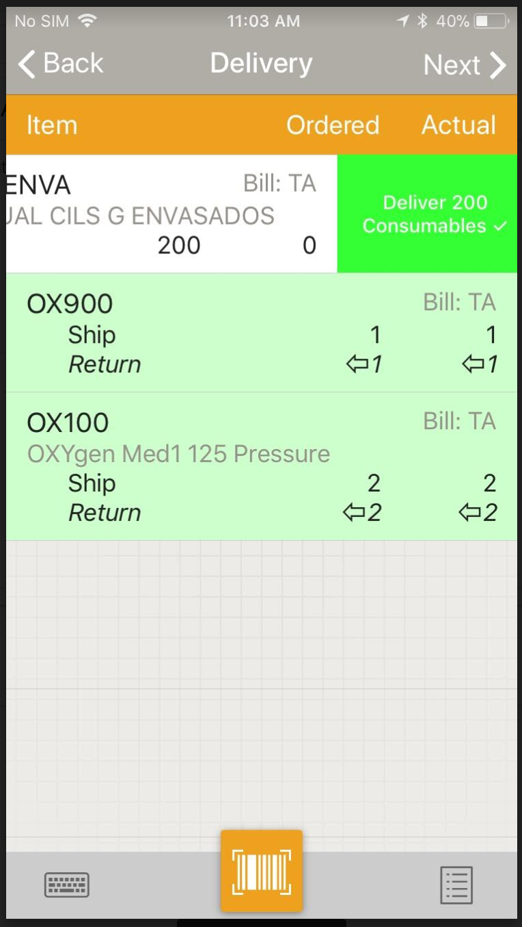
Delivering Items by Quantity
For hard goods/consumables, if the operator is fulfilling the line completely, the user can swipe to the left to complete the line

Slide 28
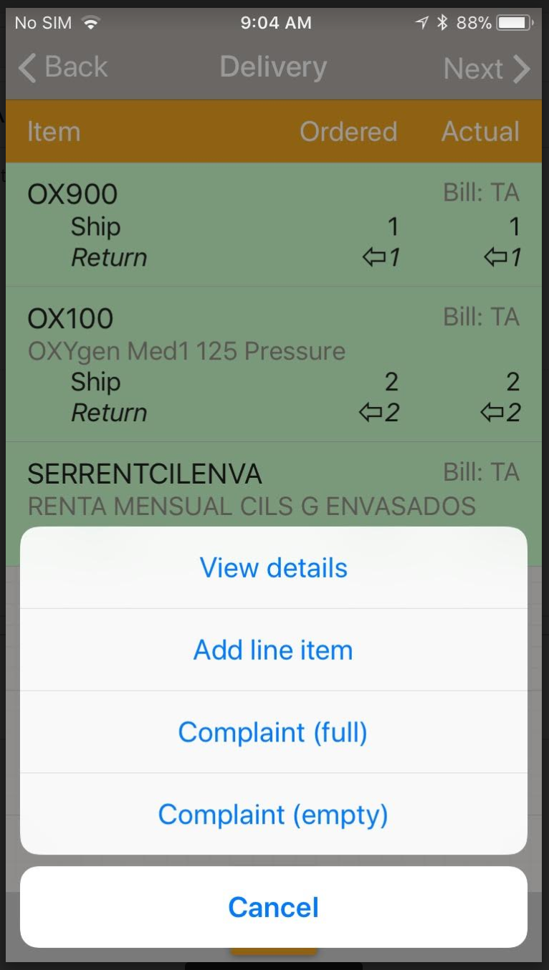
Adding Items by Quantity not on the order
If the product is not listed on the main screen, the user may tap the Note button in the bottom right hand corner of the screen and click “Add Line Item” to bring up a smart search for product codes to be added

Slide 29
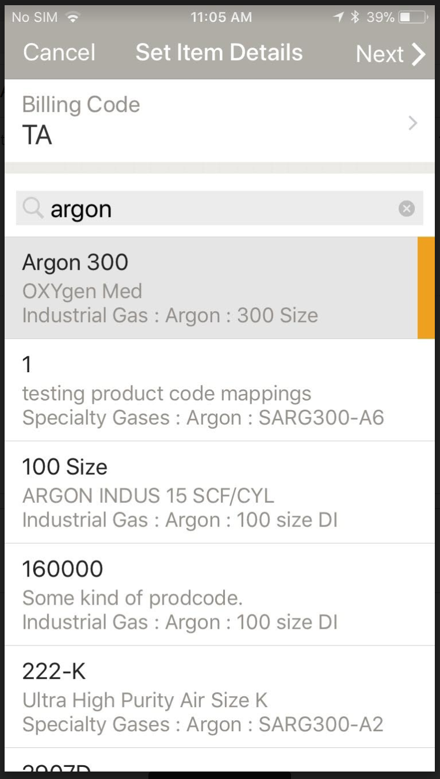
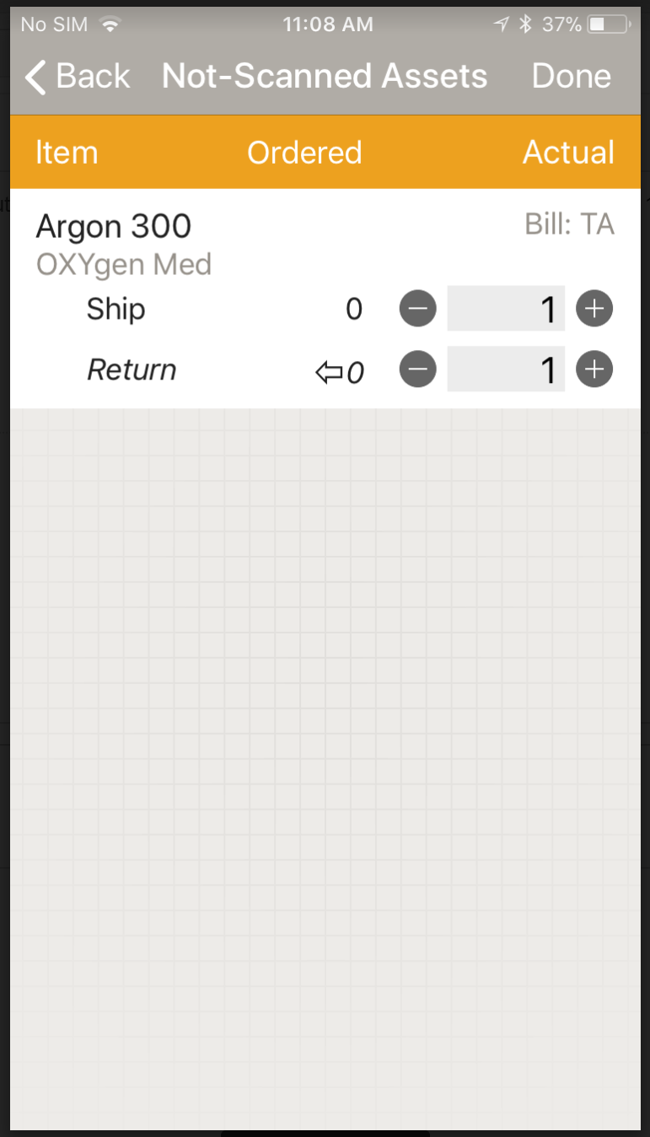
Adding Items by Quantity not on the order
The operator may select the product code or hard good code then tap Next
The operator may enter a quantity for ships and returns or use the ‘+/-’ buttons to increase or decrease quantities
Use the ‘+/-’ signs to increase or decrease the quantity or tap in the number field to bring up a numeric keypad

Slide 30
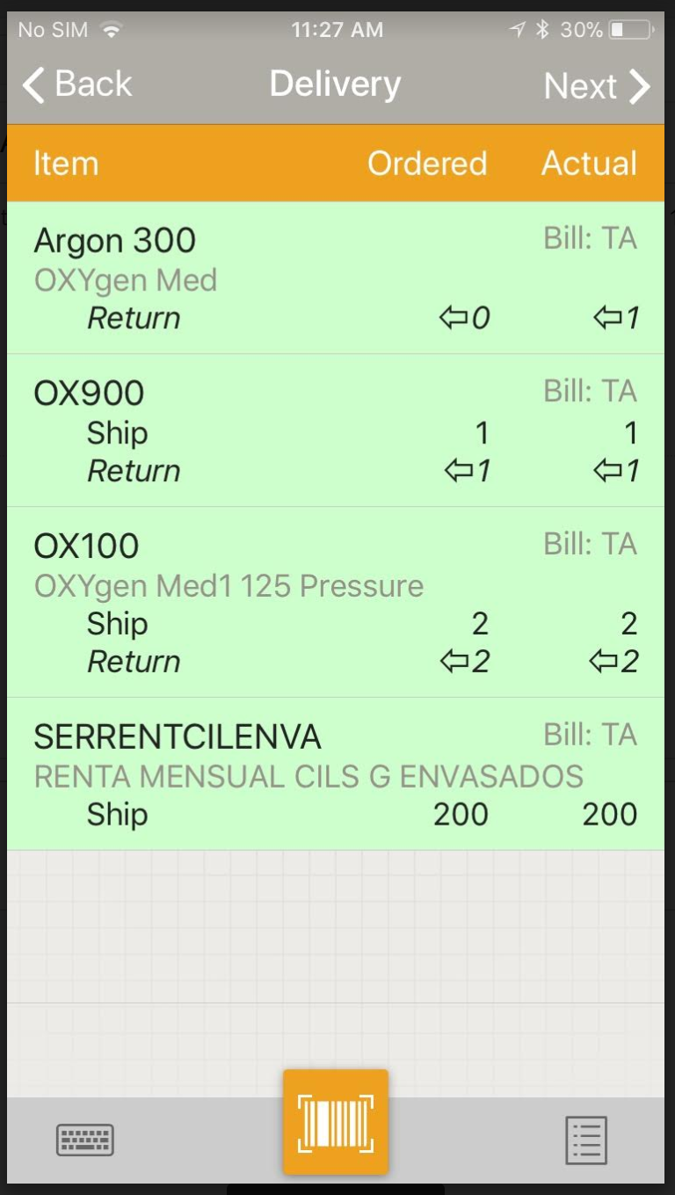
Completing a Delivery
Once all items have been scanned/added, tap the Next button in the upper right hand corner of the screen to complete the final delivery steps
If all lines that were delivered/returned match the lines on the order you will automatically be taken to the delivery confirmation screen to get the customer’s signature
NOTE: If there were returned assets scanned/added that were not part of the original order, TrackAbout will highlight the rows as green, as we assume all clients want their assets back

Slide 31
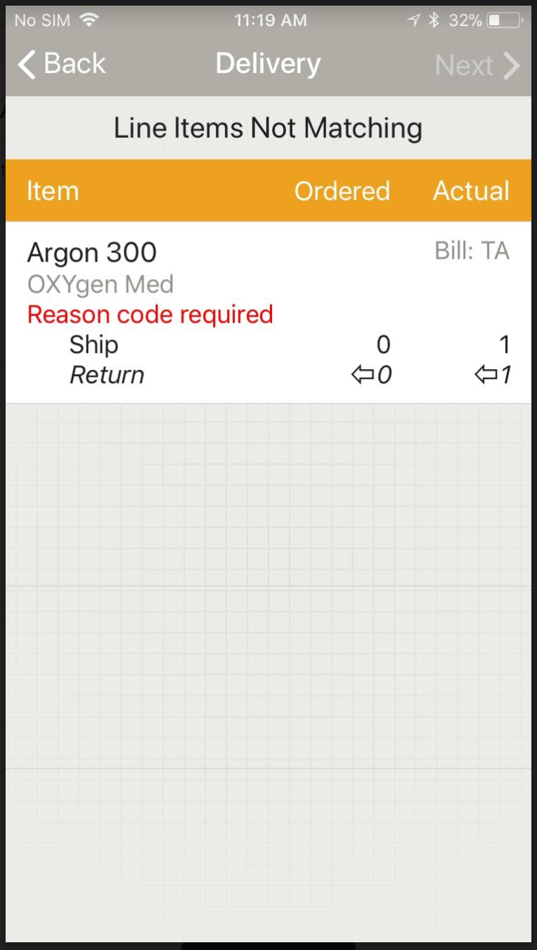
When all Lines Don’t Match
If the number of assets ordered does not match the number of assets scanned/added during Delivery, the operator will be alerted that there is a mismatch after tapping the Next button.
Tap Back to go back and fulfill each line
Tap Next To proceed with the quantities already included on the screen

Slide 32
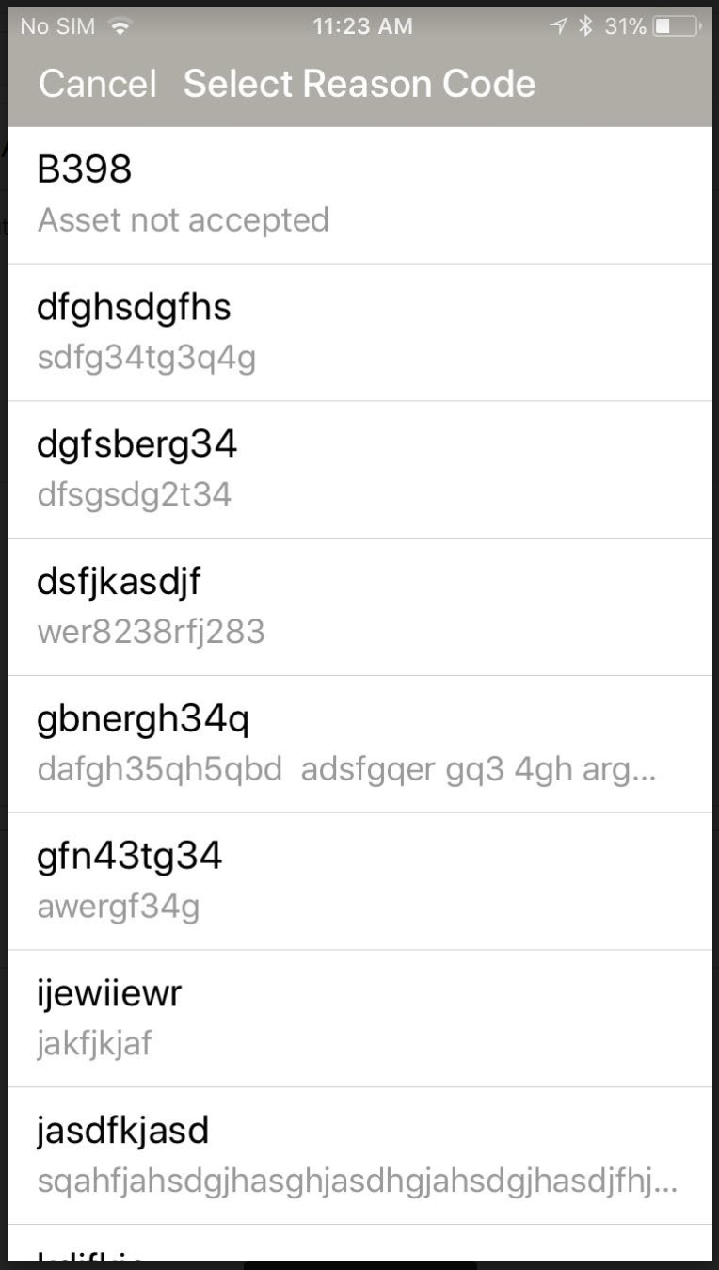
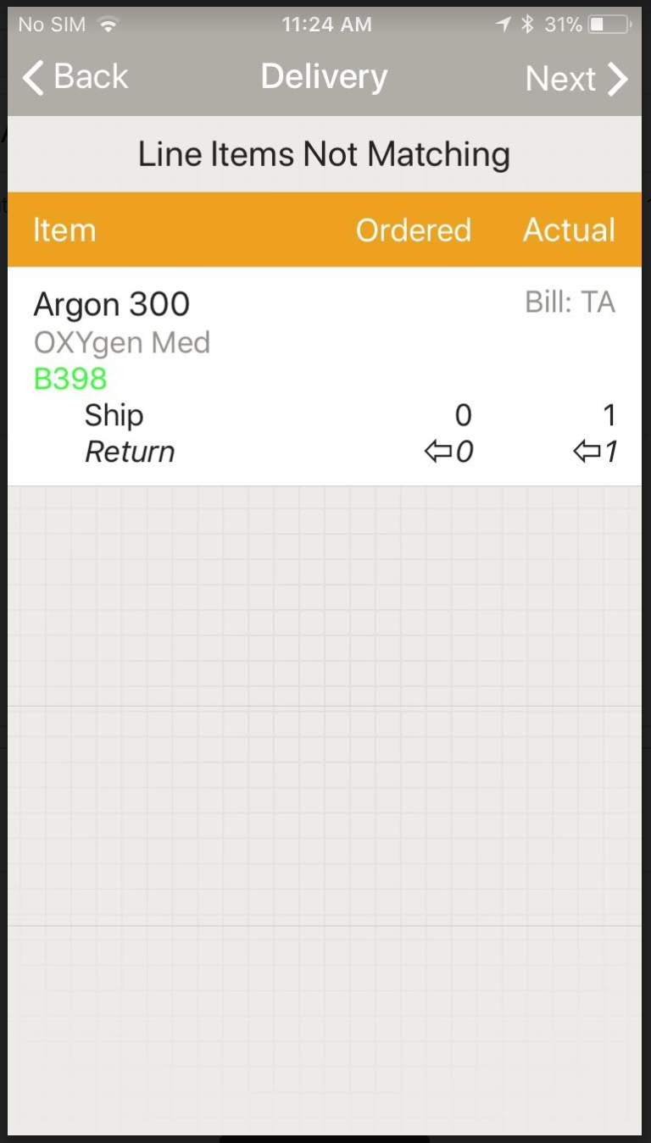
Using Reason Codes
If the operator chooses to continue to save the Delivery action with mismatched lines, customers can choose to have a list of reason codes that the operator must choose from and assign to each mismatched line
The operator may tap on each mismatched line to assign the required reason code; once assigned, the line turns green
Tap Next

Slide 33
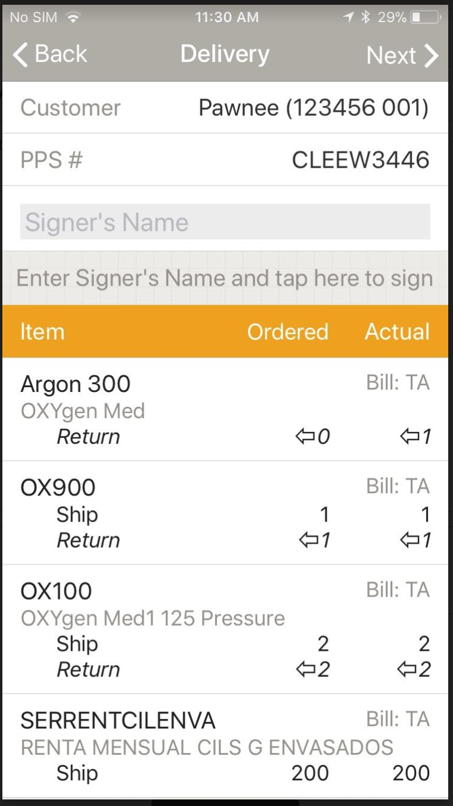
Completing a Delivery
The Delivery Confirmation screen provides the customer with a summarized view of what was ordered and delivered/picked up
Enter in the name of the customer employee accepting the delivery and tap in the space provided to have them sign

Slide 34
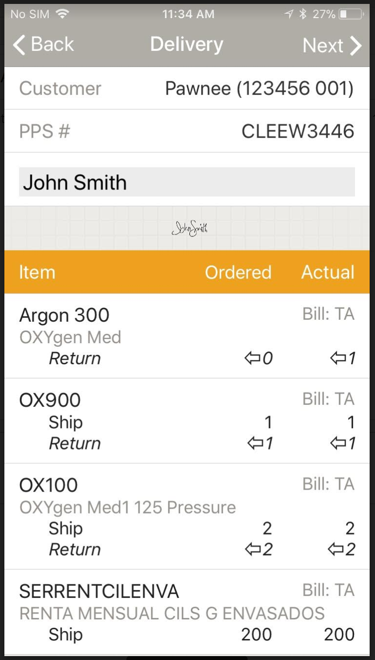
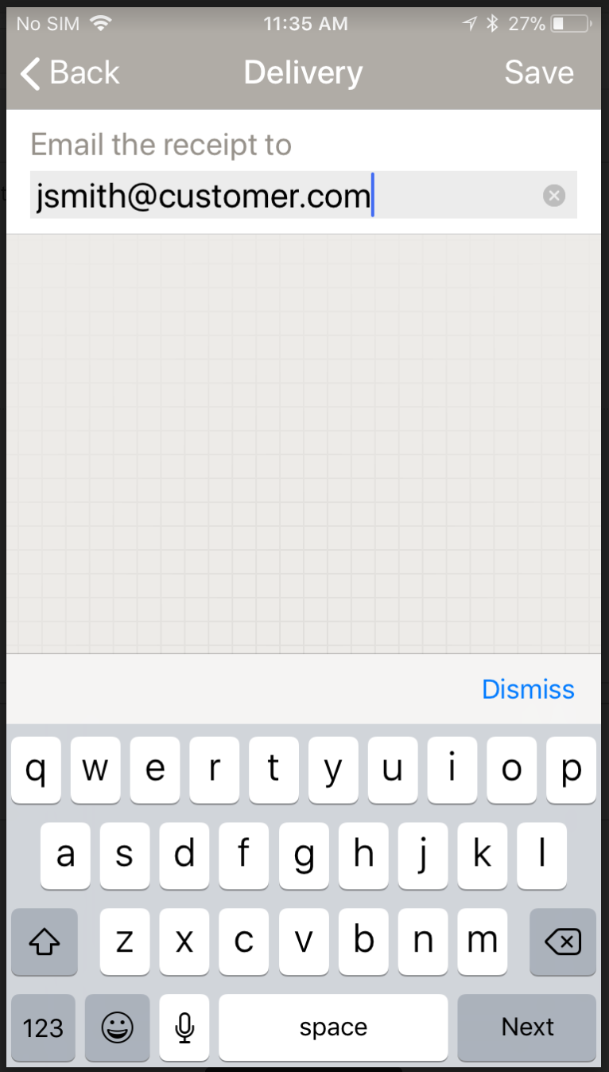
Completing a Delivery
Tap Next and Save
NOTE: The driver can optionally add in an email address where a proof of delivery will be sent. This can alternatively be set up on a customer’s profile in TrackAbout. Please contact support for more details
The use state for all assets delivered will now be Delivered, and for returns will be Empty

Slide 35
Keying in Assets and Removing Assets
The Keyboard in the bottom left hand corner of the screen allows the operator to key in by serial number/barcode
The View Details button (accessed via the Note) will allow an operator to view all barcodes and products added and will also allow them to remove erroneous assets by tapping or multi-selecting lines and then tapping the trash icon

Slide 36
Unload Truck (with Trip)
At the end of a delivery trip and when a driver comes back to the plant, operators will scan all of the assets off of the vehicle
Tap Unload Truck from the Main Menu

Slide 37
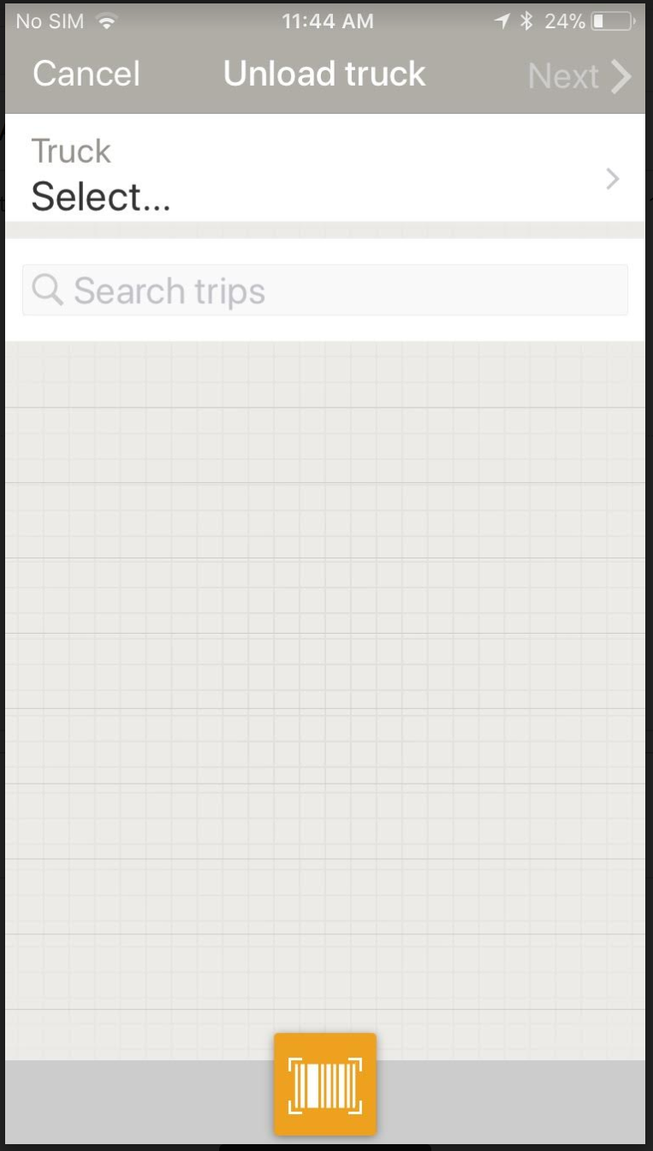
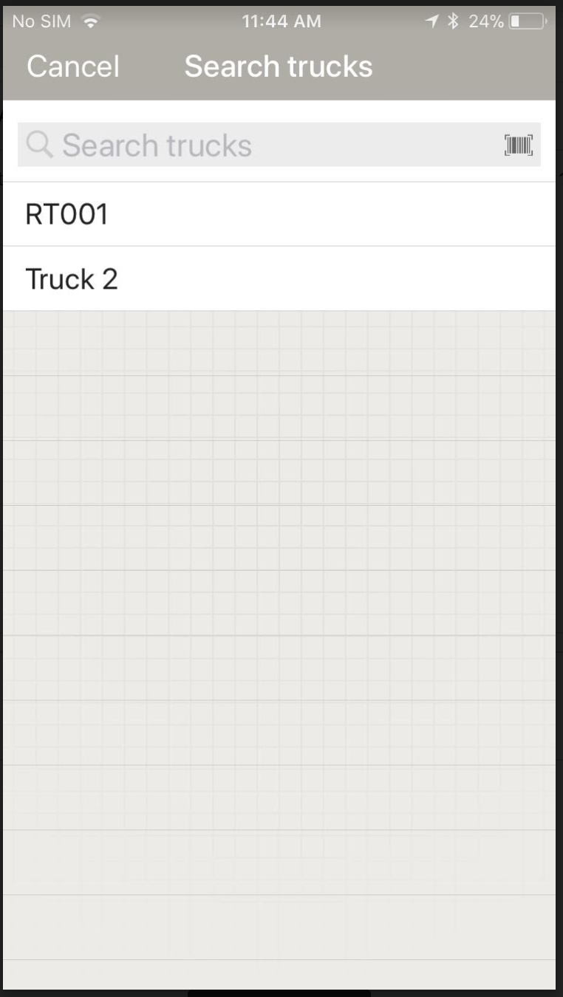
Unload Truck
When unloading a truck for a trip, the operator will be required to either scan or select a truck from the drop down menu

Slide 38
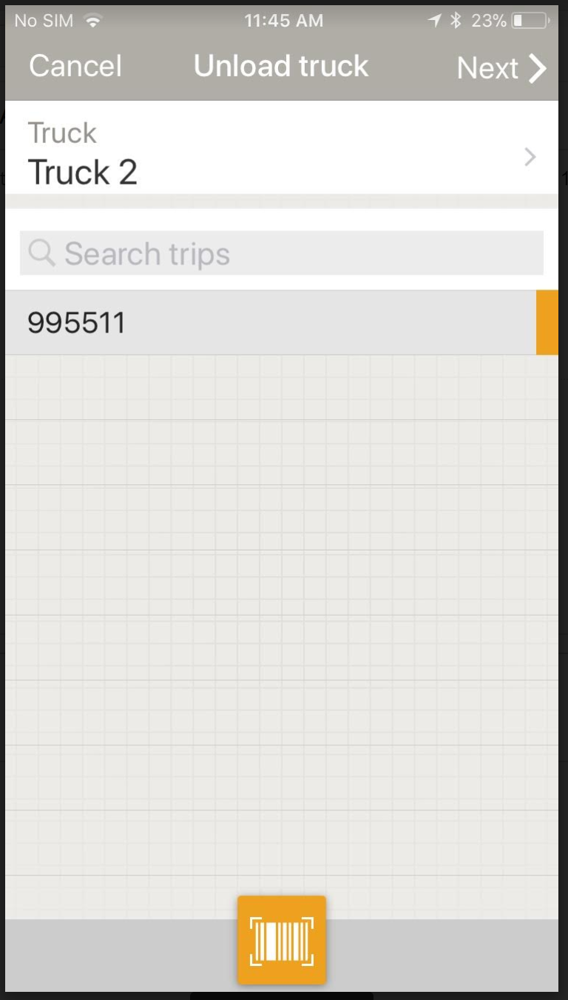
Unload Truck
Scan/type in/select the appropriate trip and tap Next

Slide 39
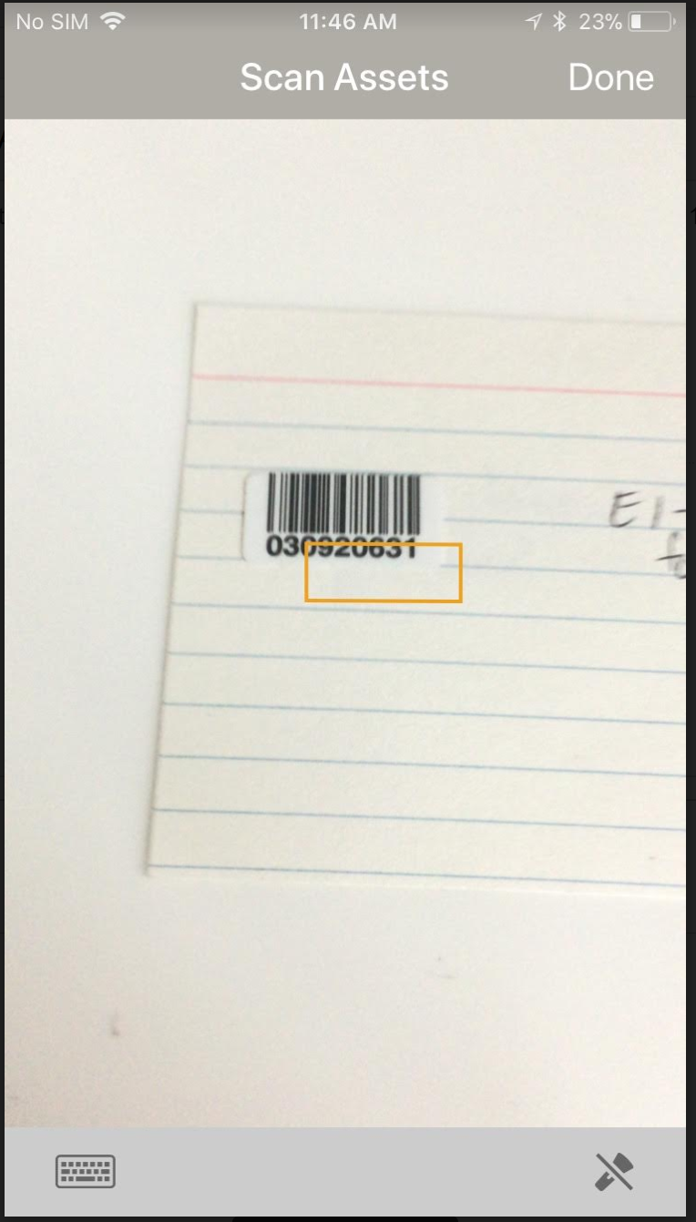
Scanning Assets off a Truck
The operator will automatically be taken to the scan screen where they can scan assets to be offloaded
When you are finished scanning, tap Done in the upper right hand corner of the screen
NOTE: You can always come back to the scanning screen by tapping the yellow scan button on the bottom of the main Unload Truck screen

Slide 40
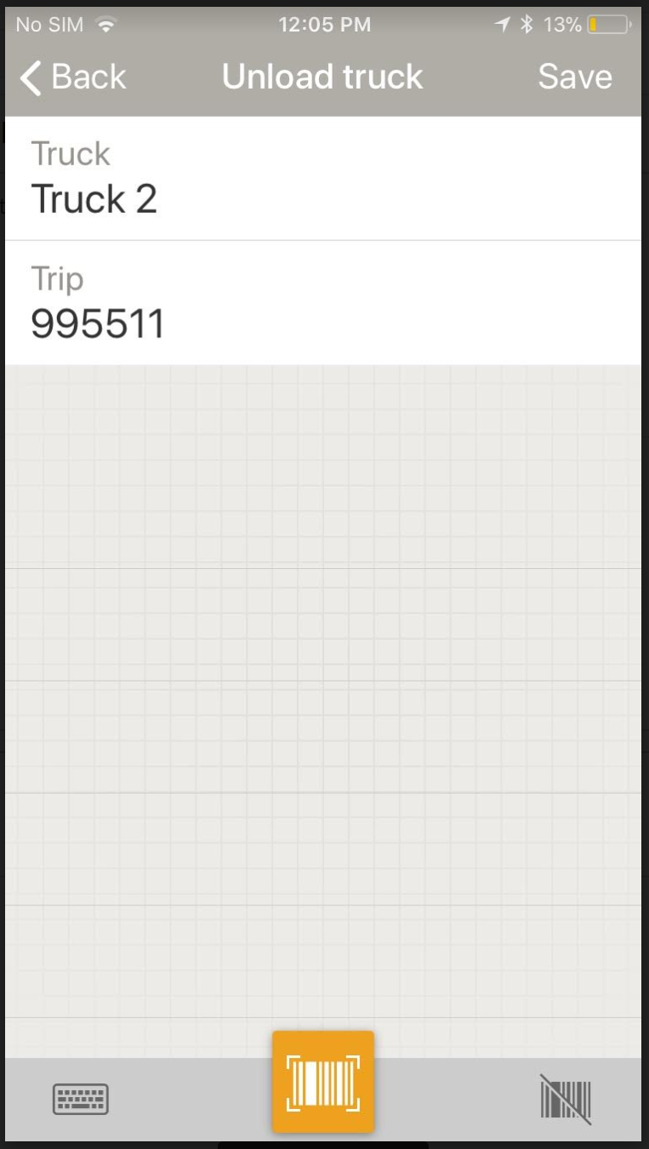
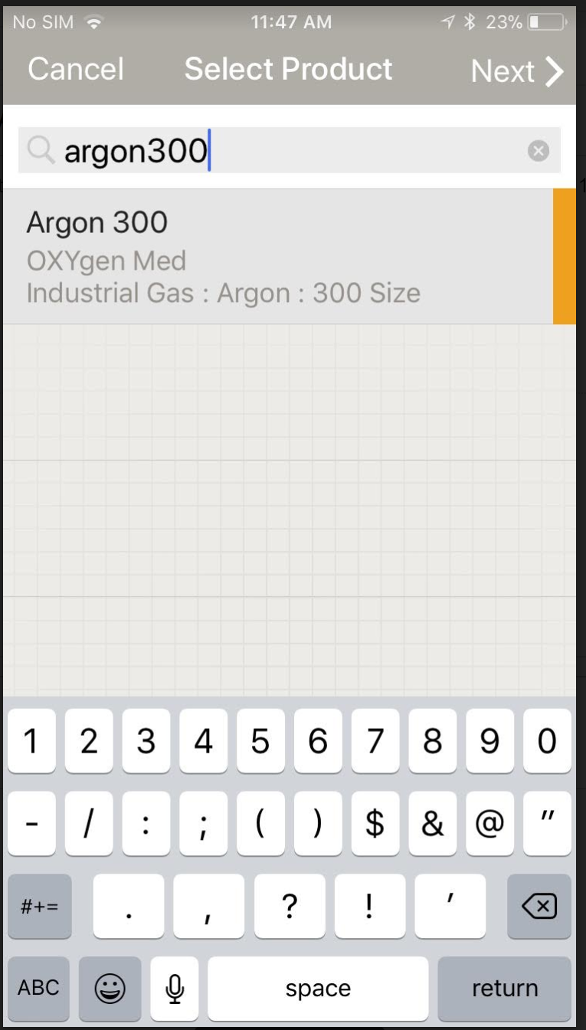
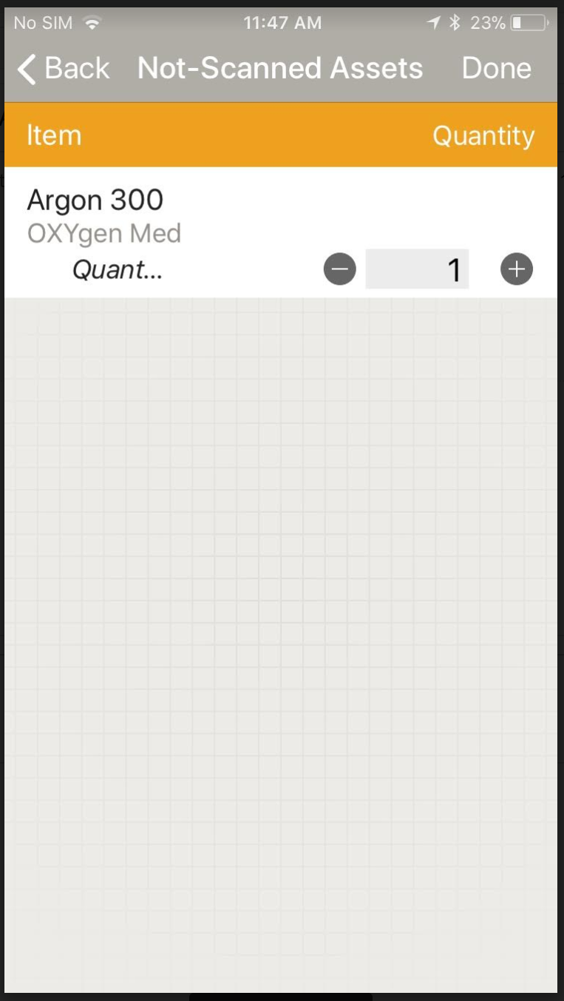
Unloading Items by Quantity
When adding items (either hard goods/consumables or regular products) by product code and quantity only (without barcodes), tap the crossed-out barcode at the bottom of the screen to enter by item and quantity as in Picking and Delivery
NOTE: For customers using Full/Empty Codes, be sure to type in the empty product code for assets being returned

Slide 41
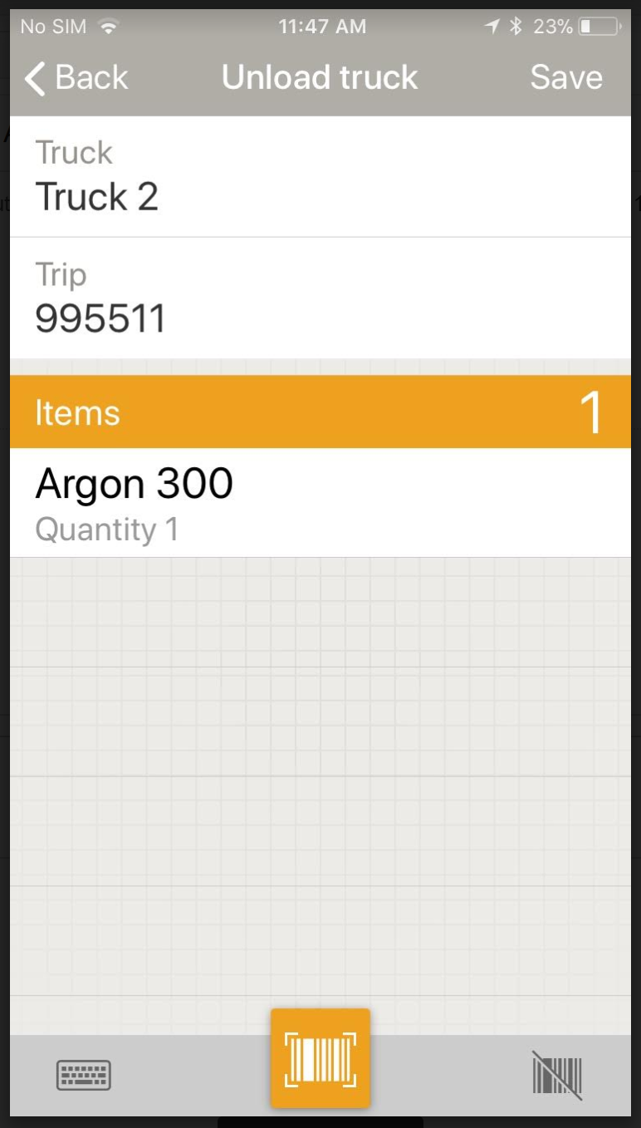
Completing Unload Truck
After the truck has been completely unloaded, tap Save in the upper right hand corner
The location of the assets will now change to the plant, but use states will remain the same

